Slide 1
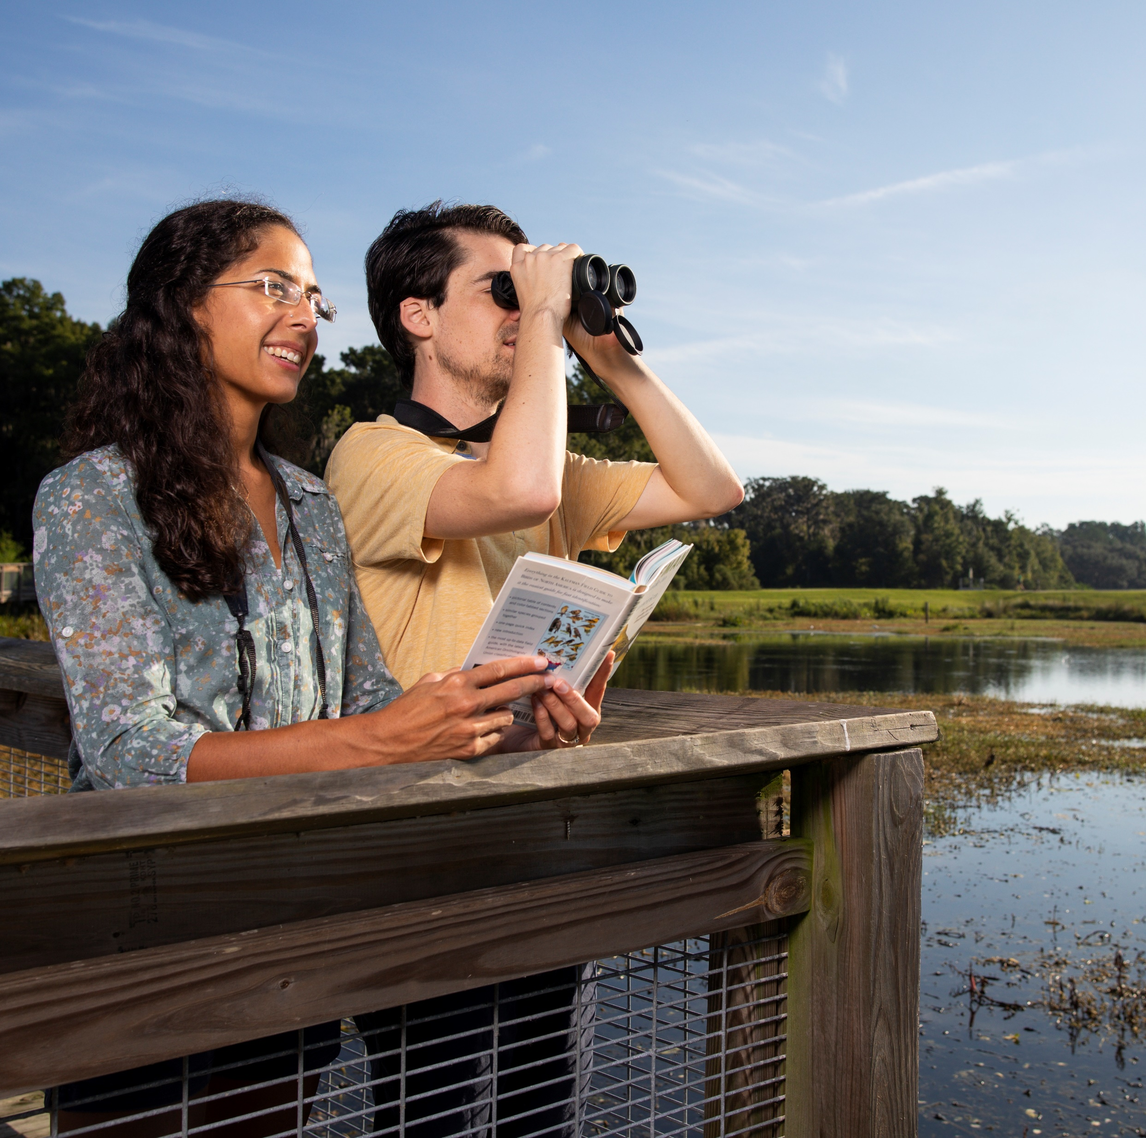


Current Applications and Future Potential of Citizen Science Data
Brittany M. Mason and Corey T. Callaghan

Slide 2
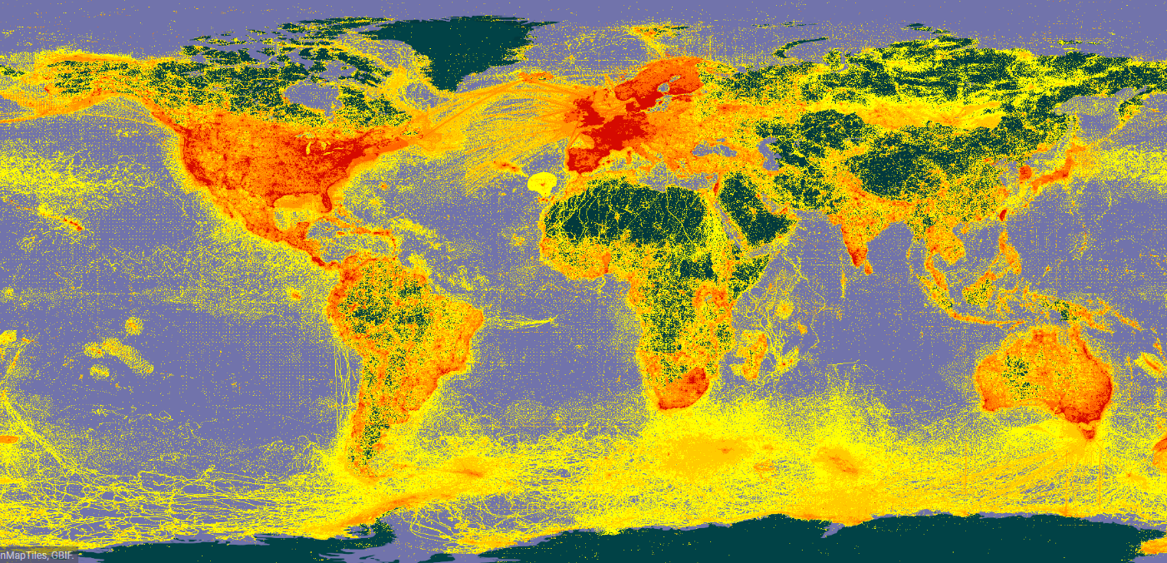



What is Citizen Science?
Also commonly referred to as participatory science or community science
Involves public engagement, education, and data collection
Citizen science programs are interdisciplinary and result in scientific advancement
Jordan et al. 2015. Citizen science as a distinct field of inquiry

Slide 3
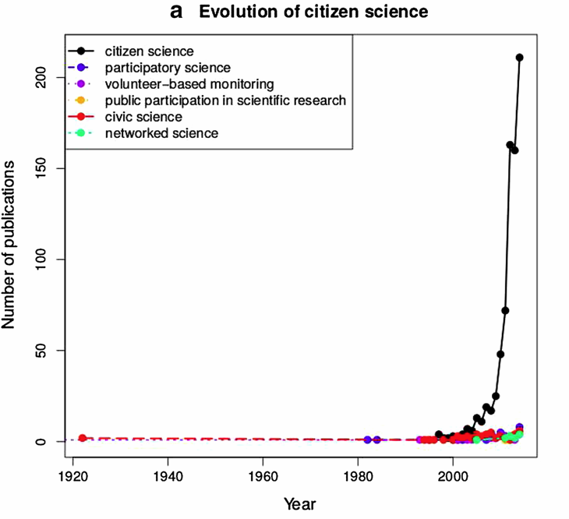
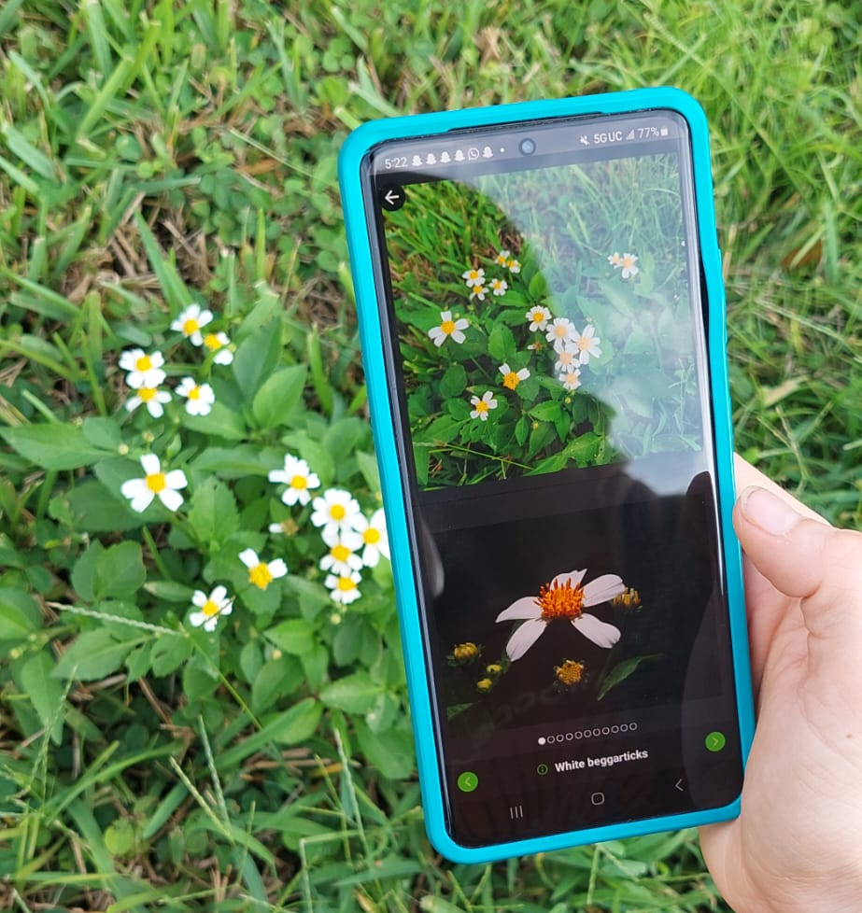
A Growing Field
Advancements in technology has made citizen science more popular and accessible
Welvaert, M, and P. Caley. 2016. Citizen surveillance for environmental monitoring: combining efforts of citizen science and crowdsourcing in a quantitative data framework. SpringerPlus 5:1890.

Slide 4
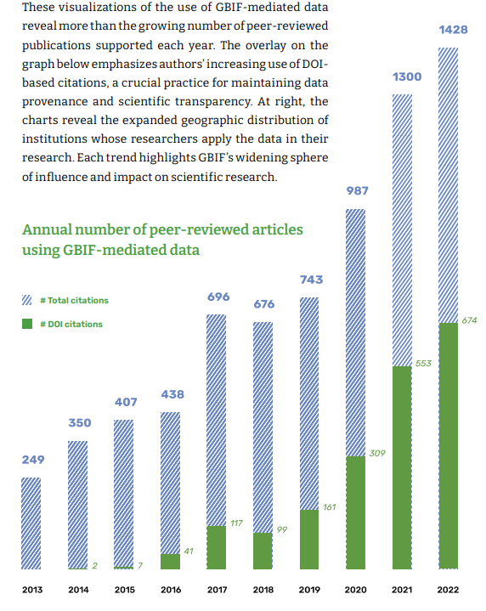
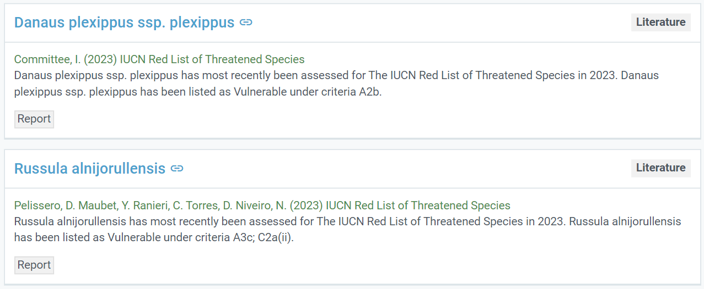
How is Citizen Science Data Being Used?
GBIF Secretariat (2023) GBIF Science Review No. 10. https://doi.org/10.35035/37pp-tt84
Citizen science data is used in published papers and to inform policy
However, these uses are rarely summarized
>20,000

Slide 5
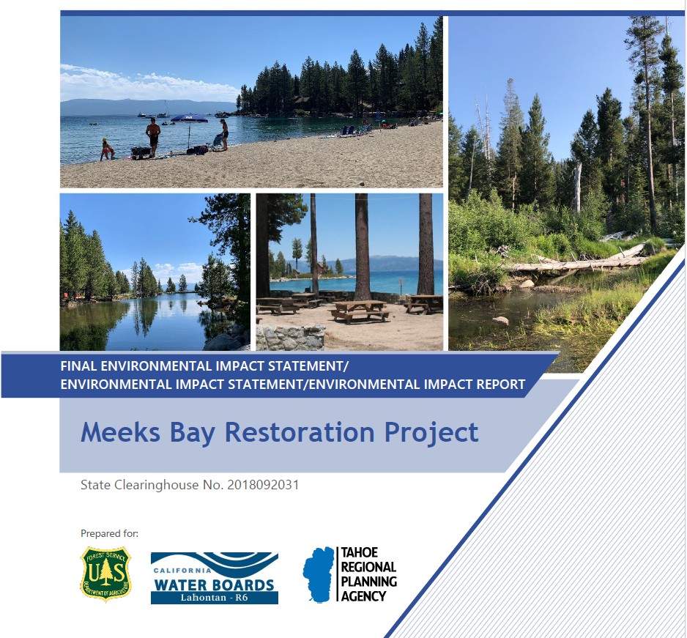
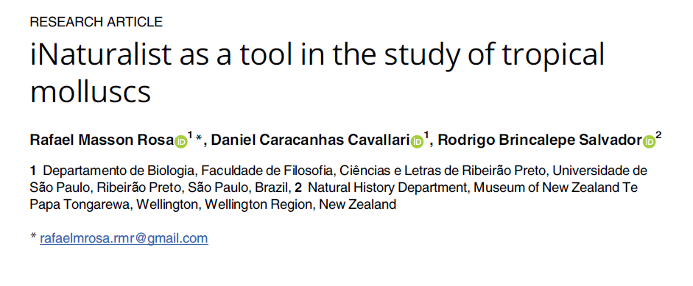
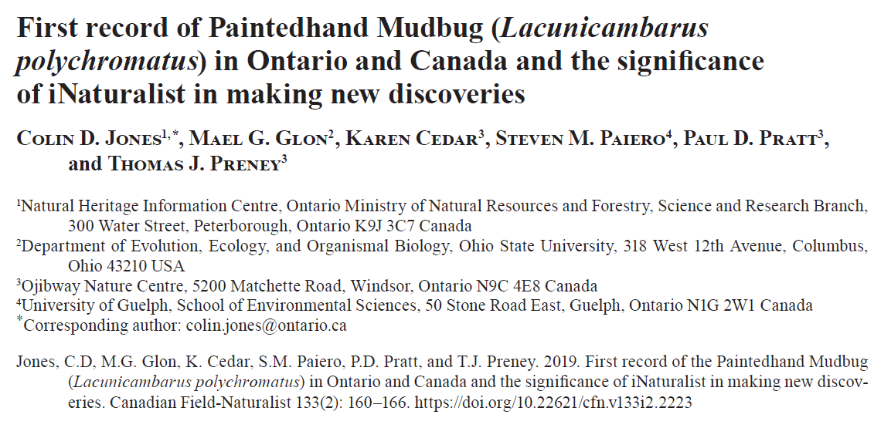
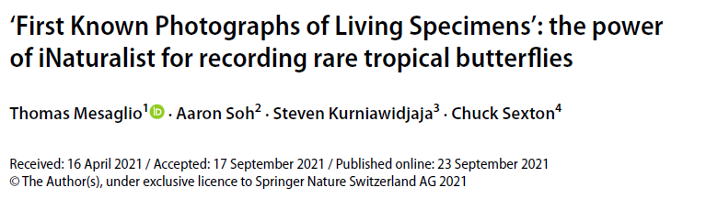
Citizen Science
Research
Policy
Study location, species, topics, analysis types, and data role of iNaturalist in the scientific literature.
Frequency and type of citizen science use in policy documents.

Slide 6
Summarize the Use of Citizen Science
Peer-reviewed literature
Environmental Impact Statements
Environmental Impact Statements

Slide 7



Paper Search
Collaborative effort of 14 researchers from around the world
We searched for peer-reviewed literature using the term “iNaturalist” on Web of Science, Scopus, Science Direct, and Google Scholar
Google Scholar searched the entire article for the term “iNaturalist” not just title or abstract

Slide 8
Inclusion Criteria
Written in English or Spanish
Peer-reviewed, scientific article
The paper uses iNaturalist data or deeply discusses the platform
Accessible using institutional credentials and electronically available

Slide 9
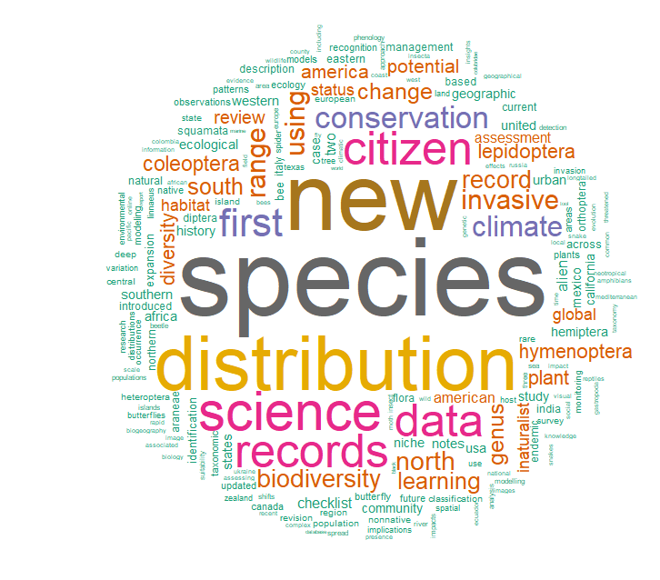
Literature Review Results
Our search produced 11,002 articles, of which 2,560 met our search criteria
Here we present preliminary analysis results on 645 articles that have been tagged

Slide 10
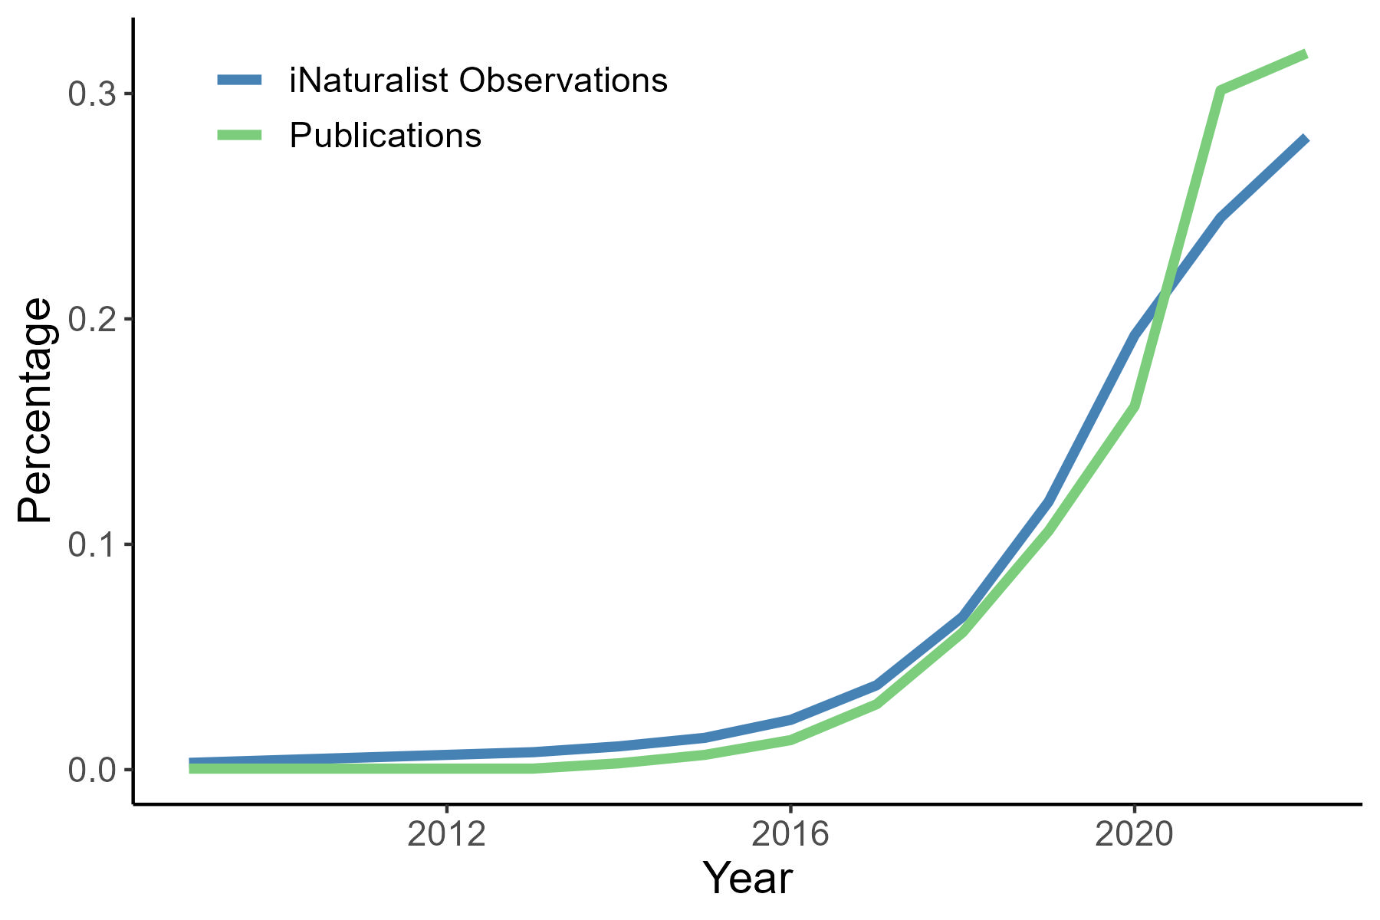
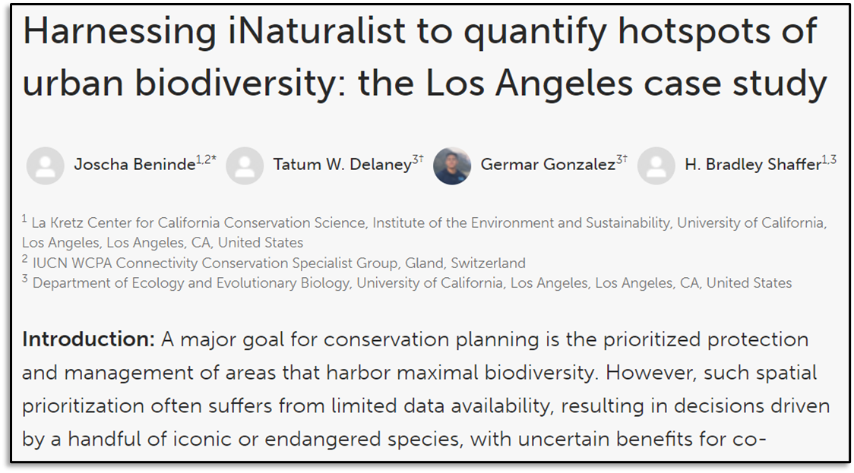
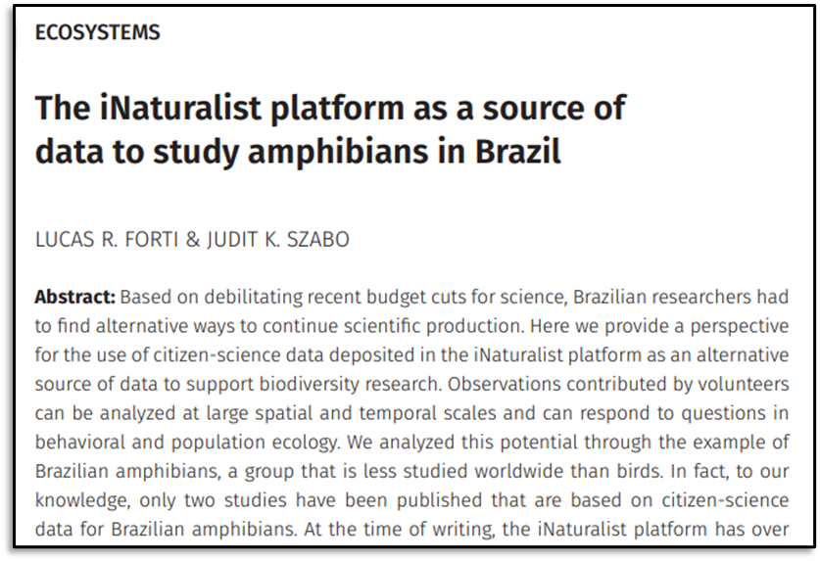
Increasing number of articles that mention iNaturalist!
30
20
10
0

Slide 11
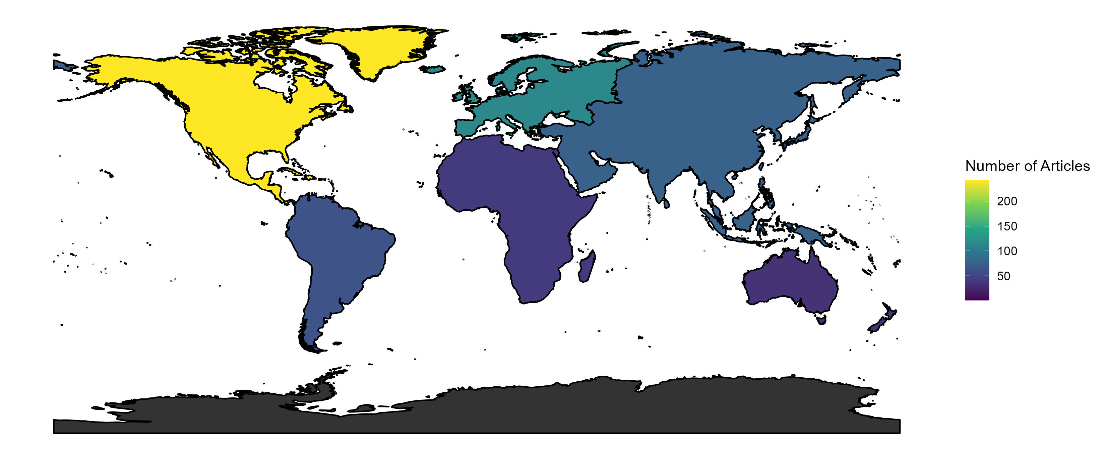
Study area of articles using iNaturalist data

Slide 12
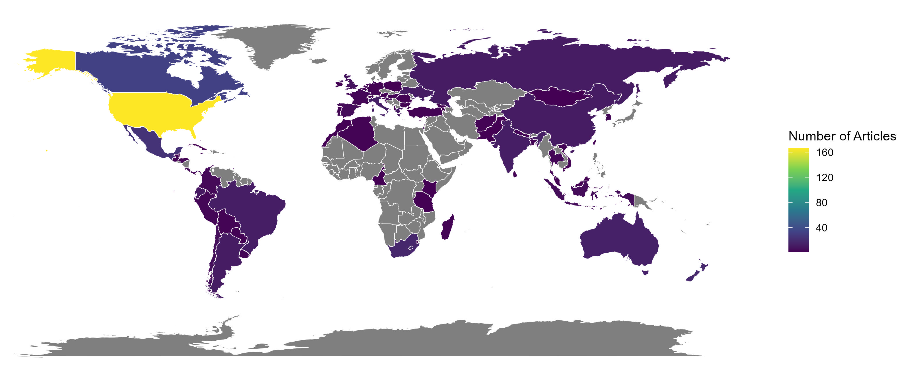
Study area of articles using iNaturalist data

Slide 13
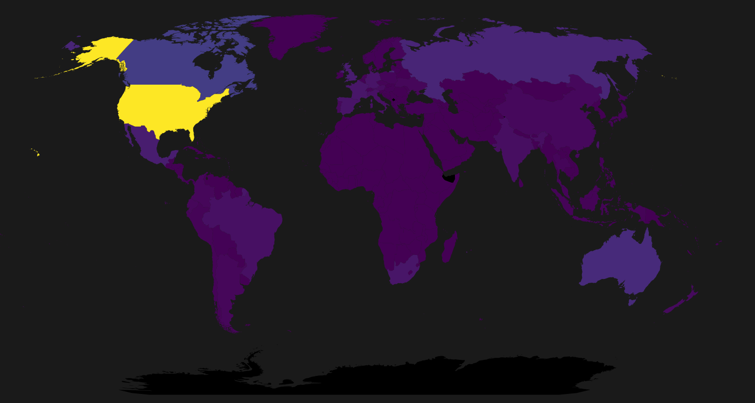
iNaturalist observations by country in 2023

Slide 14
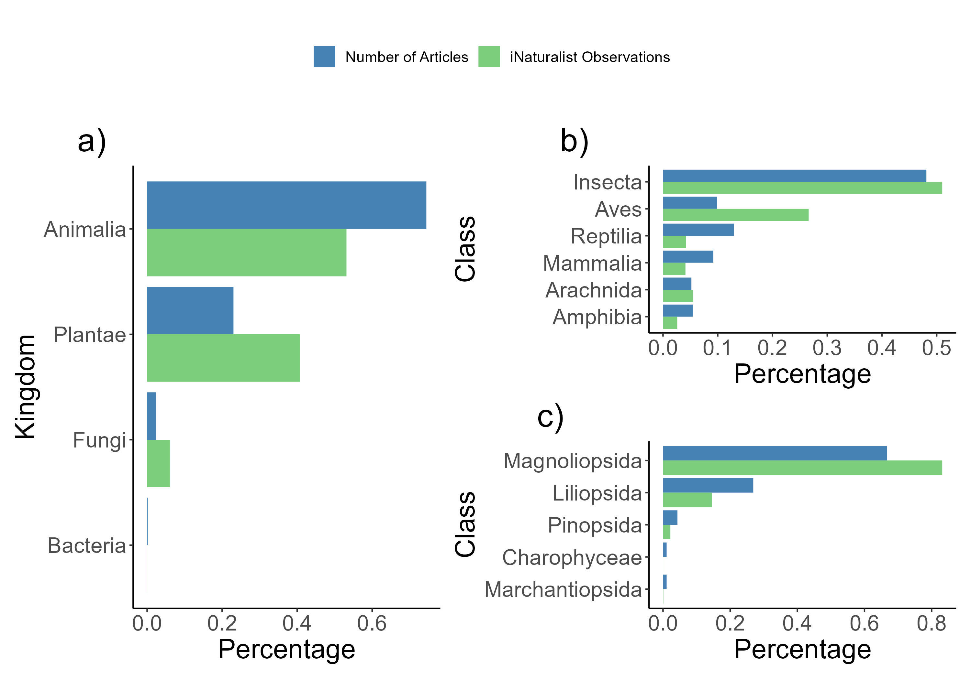

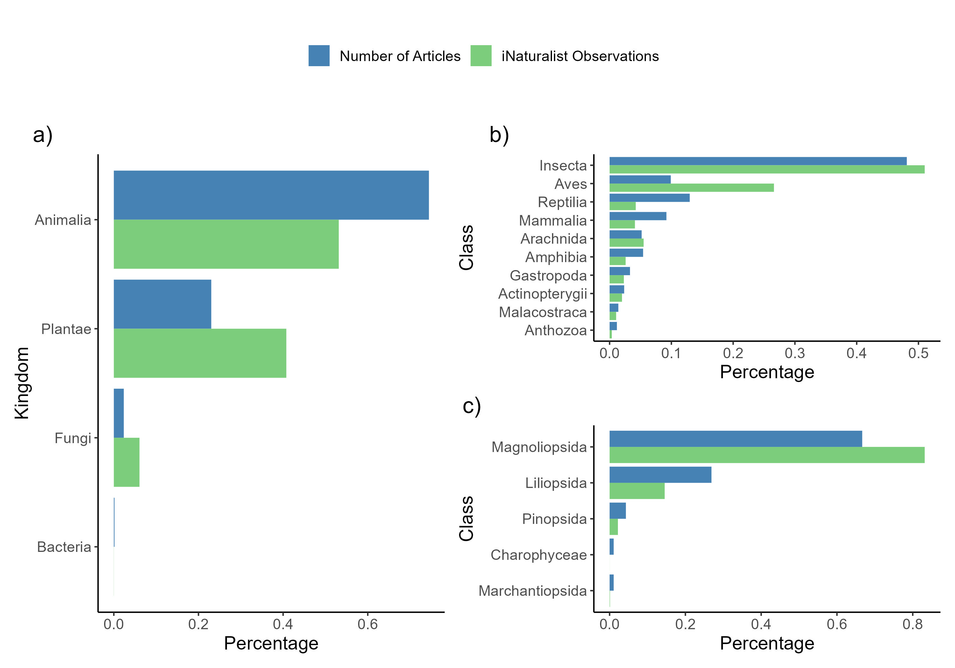

Study taxon of articles that use iNaturalist data
Animalia
Animalia
Animalia
Plantae
0 10 20 30 40 50
Plantae
0 20 40 60 80
0 10 20 30 40 50
0 20 40 60
0 20 40 60 80

Slide 15
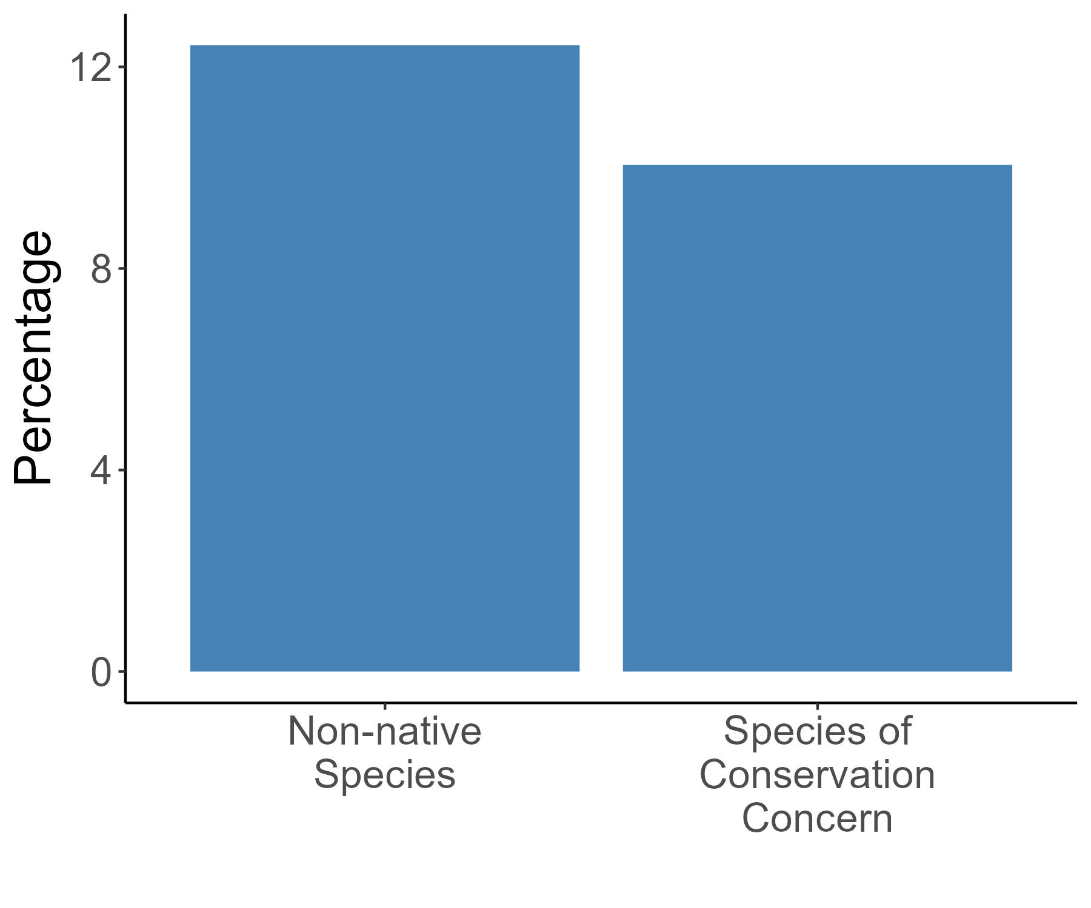
Species Status

Slide 16
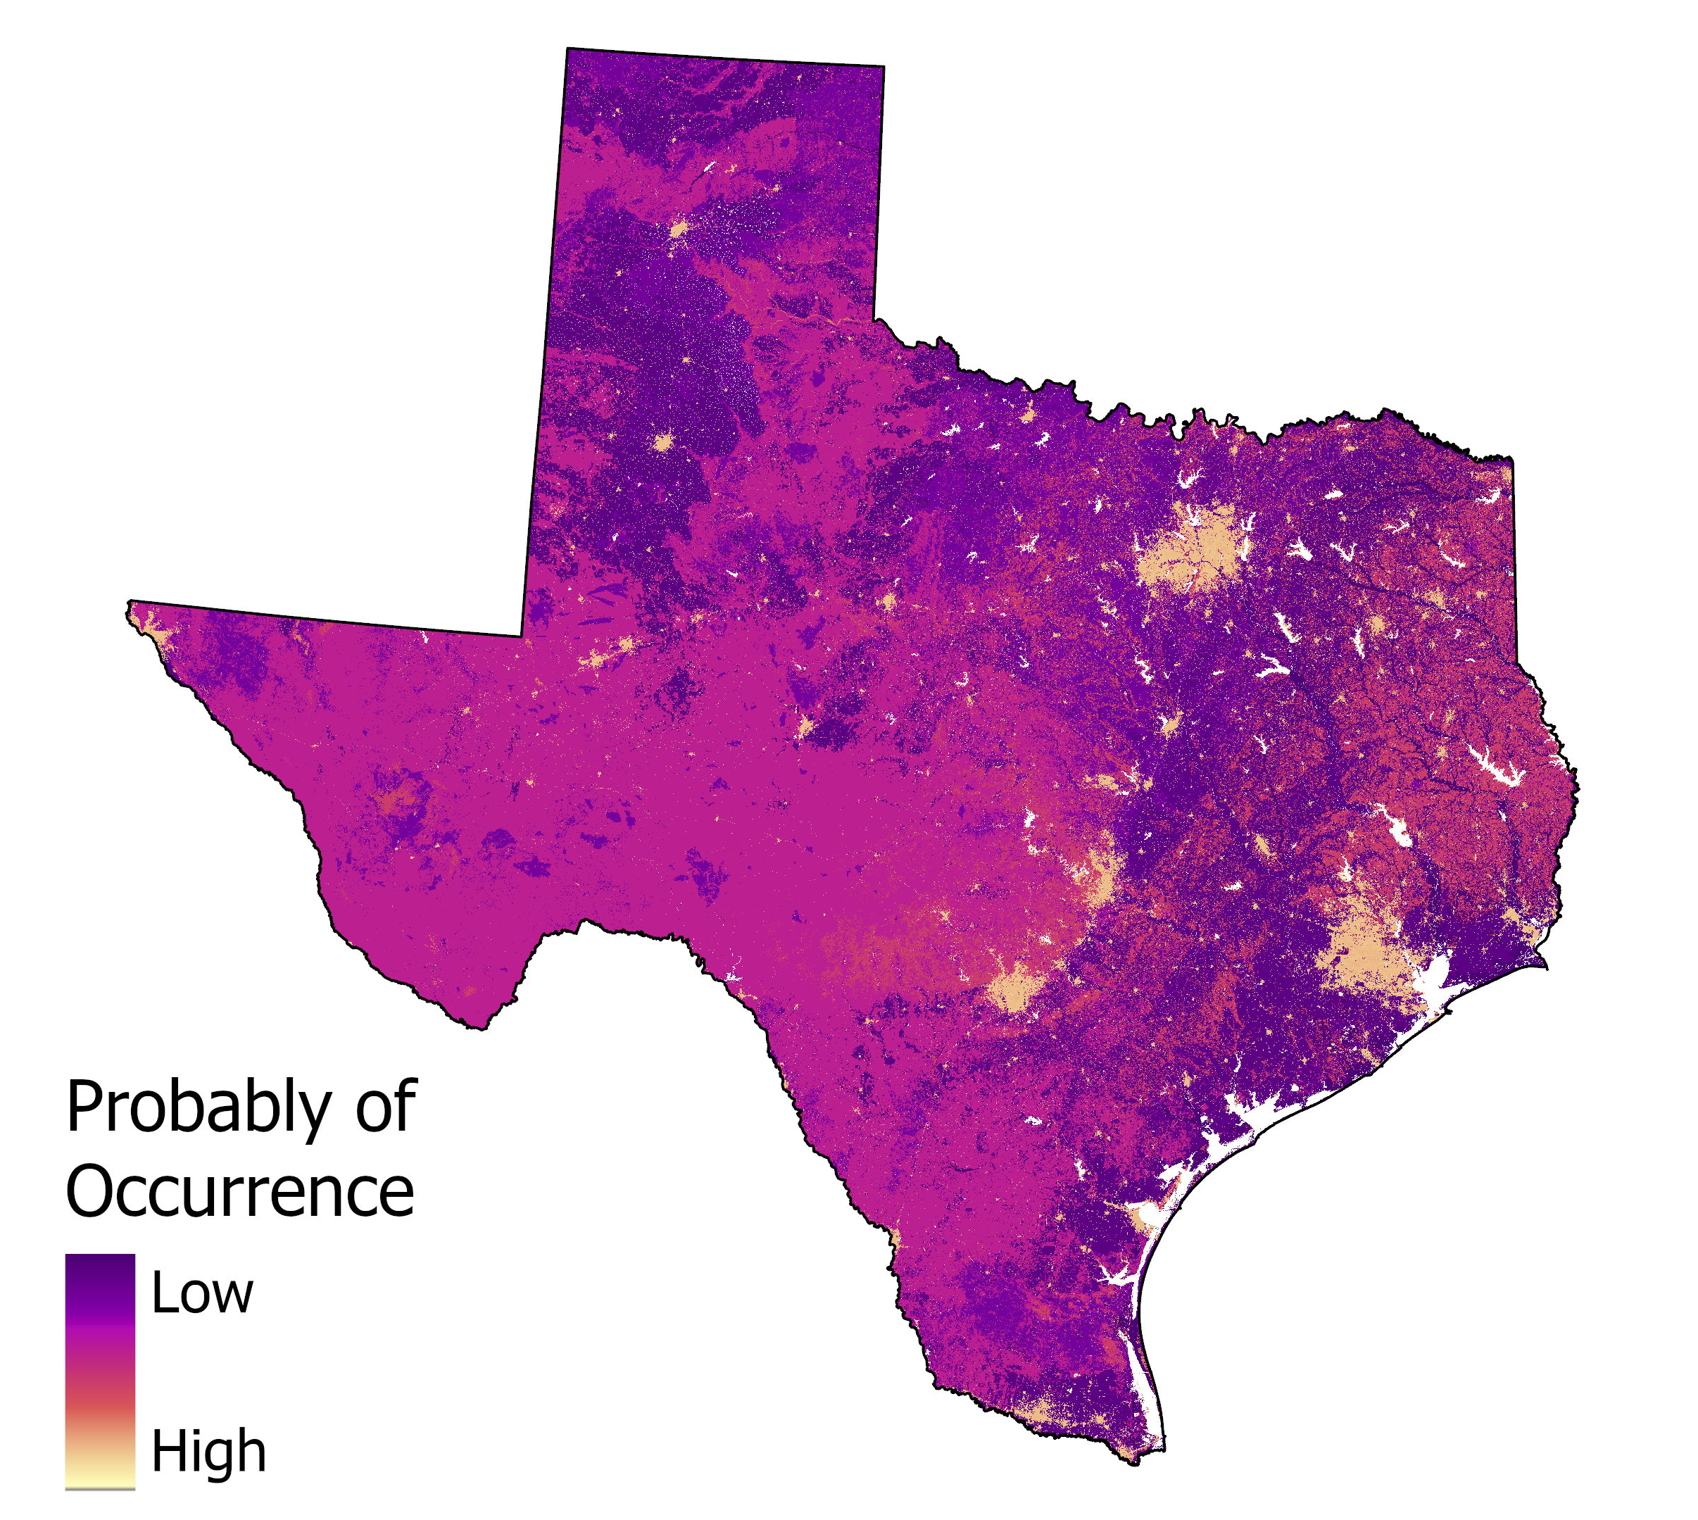
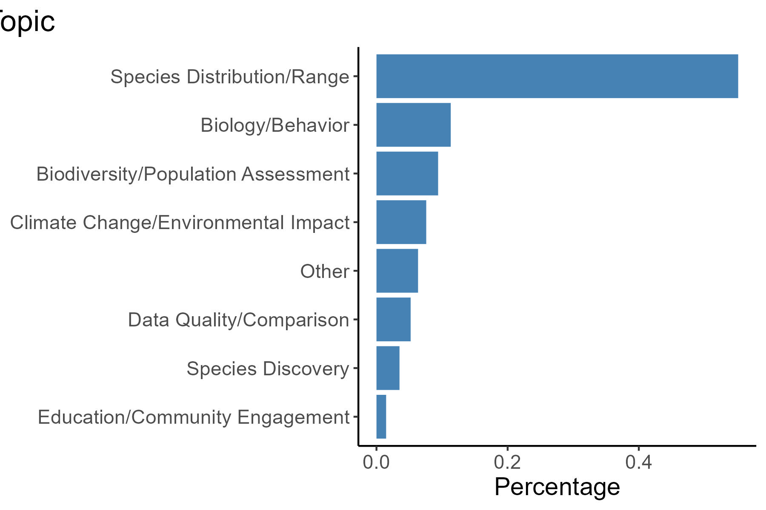
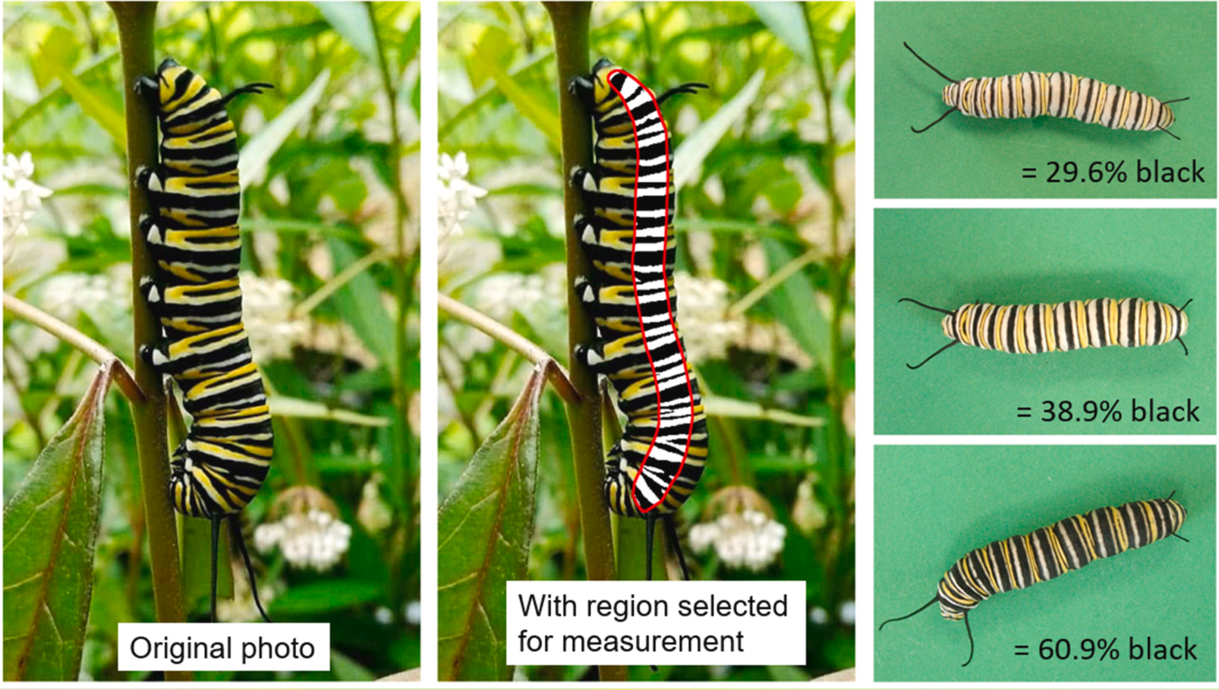
Count of topics addressed using iNaturalist data
0 20 40
Davis, A. K., Nibbelink, N., & Deneka, C. J. (2022). Revisiting geographic variation in melanism of monarch butterfly larvae in North America using iNaturalist photos. Journal of Thermal Biology, 110, 103374.

Slide 17
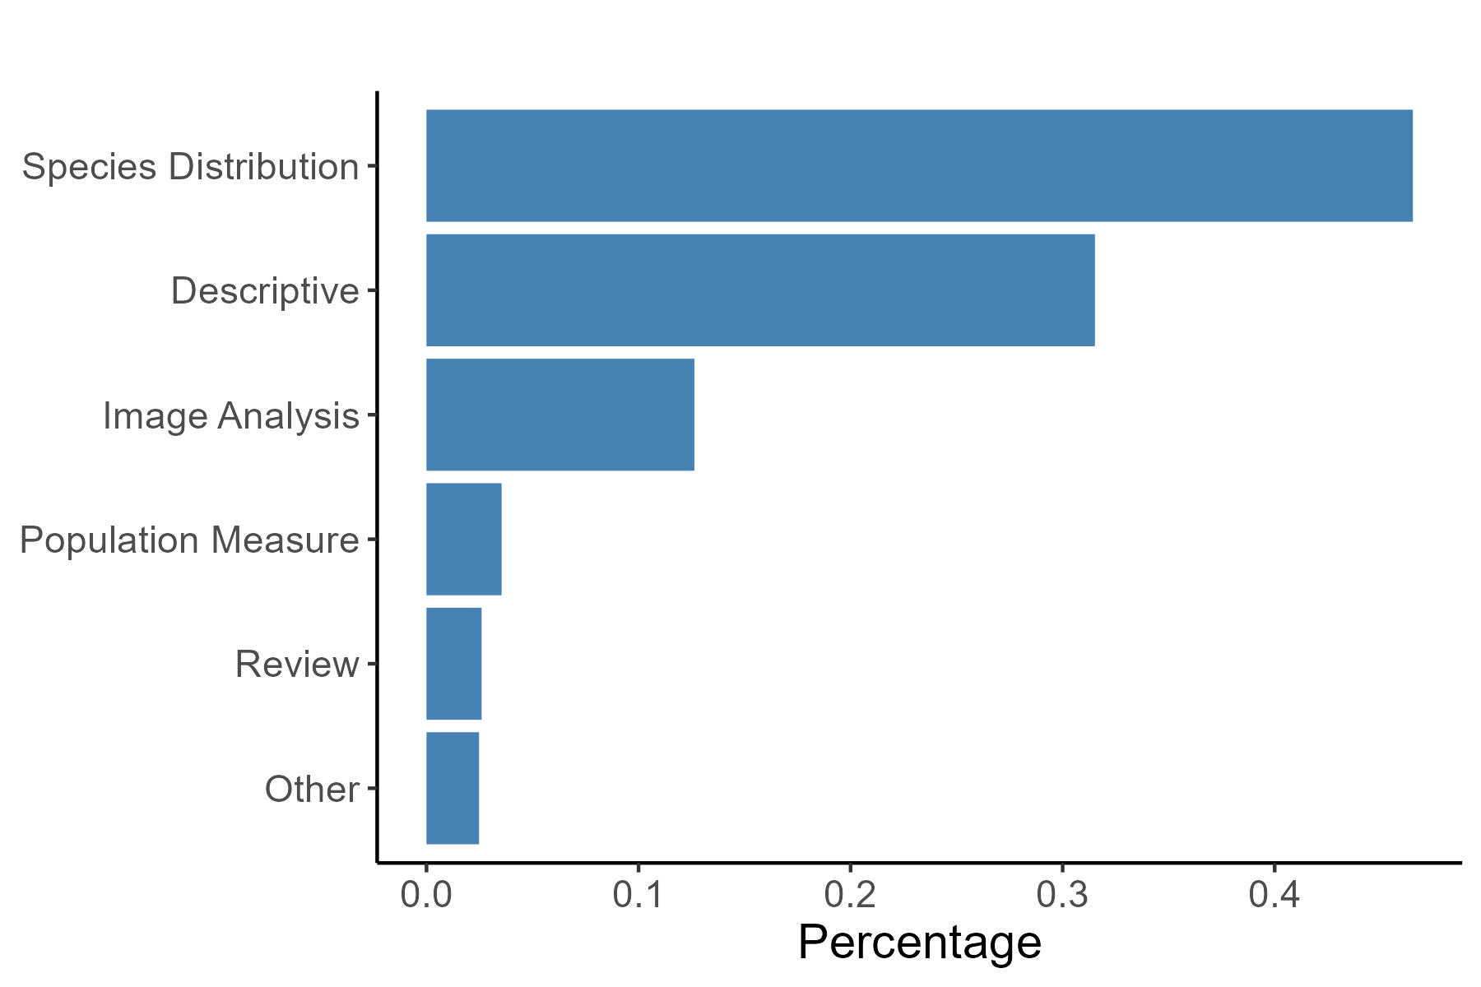

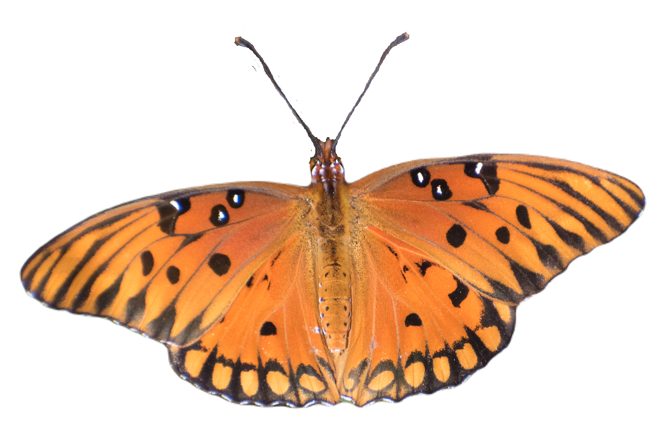
Count of analyses used on iNaturalist data
0 10 20 30 40

Slide 18
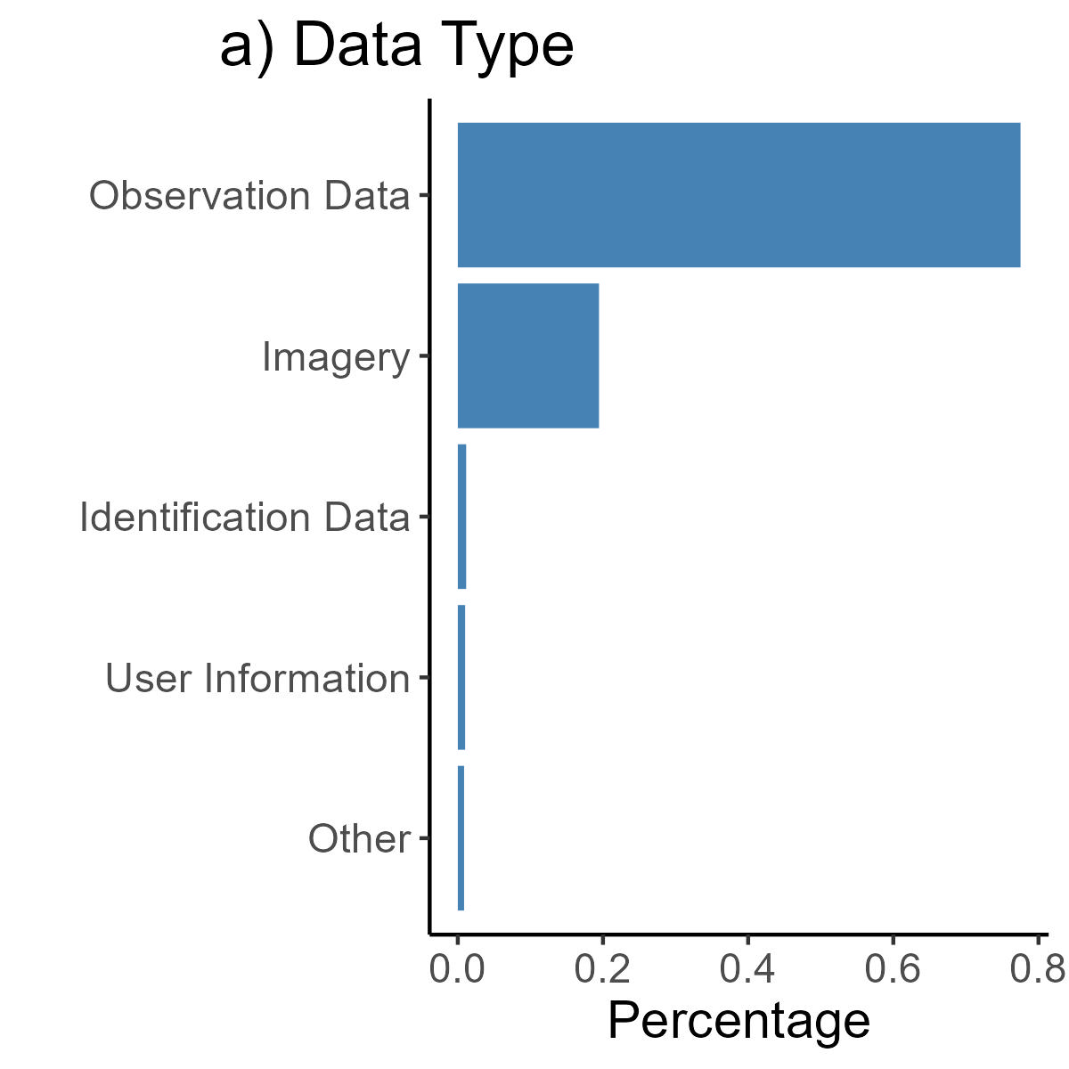
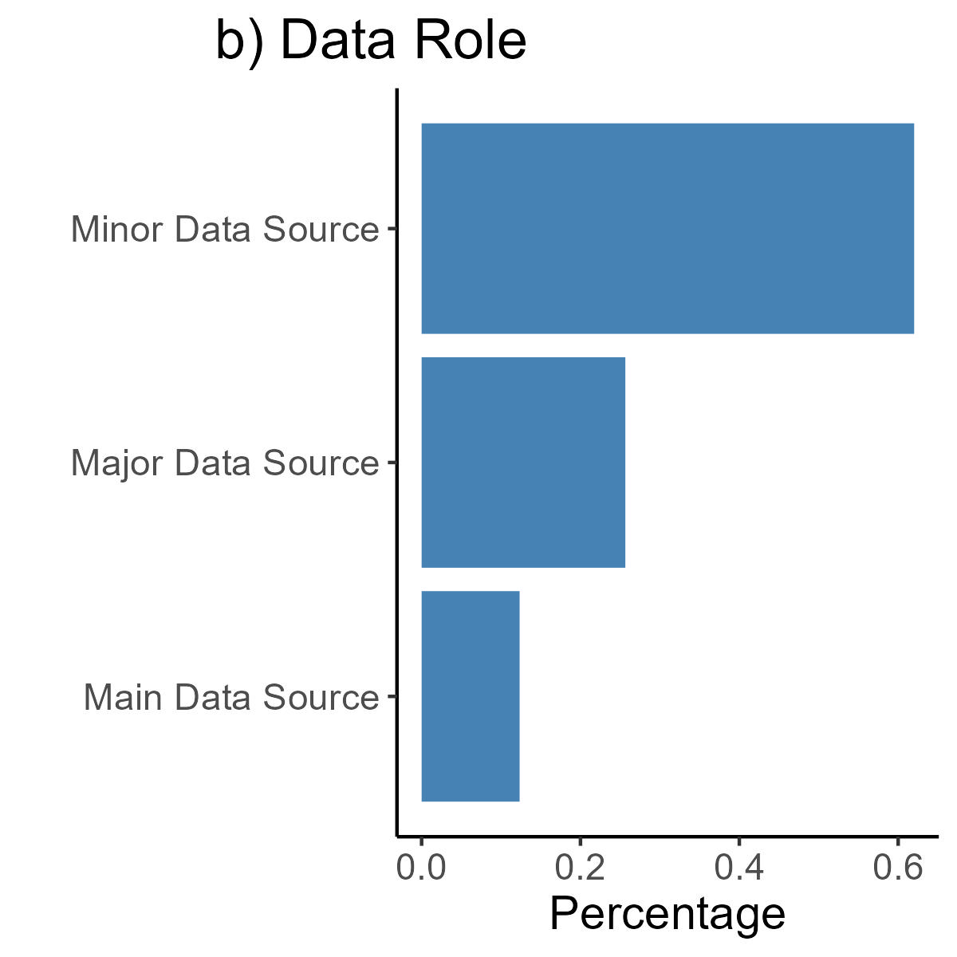
iNaturalist data types and their role in the literature
Data Type
Data Role
0 20 40 60 80
0 20 40 60

Slide 19
Summarize the Use of Citizen Science
Environmental Impact Statements
Peer-reviewed literature
Peer-review literature

Slide 20
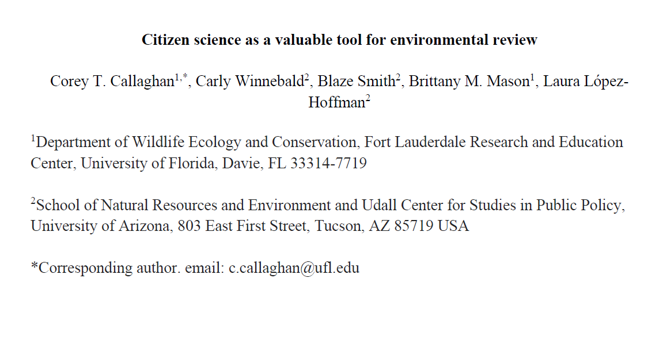

Slide 21
United States National Environmental Policy Act (NEPA)
Involves science and the public in federal decision-making
Requires environmental review of potential impacts of proposed federal action
There are three levels of analysis under NEPA – Environmental Impact Statements (EIS), Environmental Assessment, and Categorical Exclusion

Slide 22
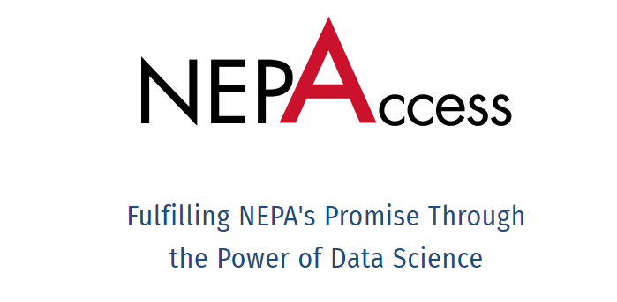
Environmental Impact Statement Search
We searched the NEPAccess database for EISs completed between 2012-2022 that contain the following keywords:
Citizen science
Community science
eBird
iNaturalist
We searched 1,355 EIS documents of which 228 were used in analysis

Slide 23
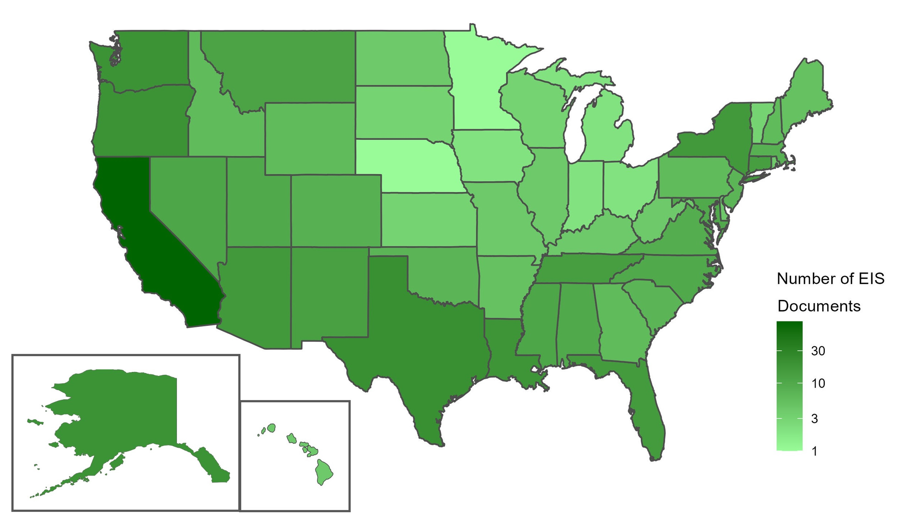

Slide 24
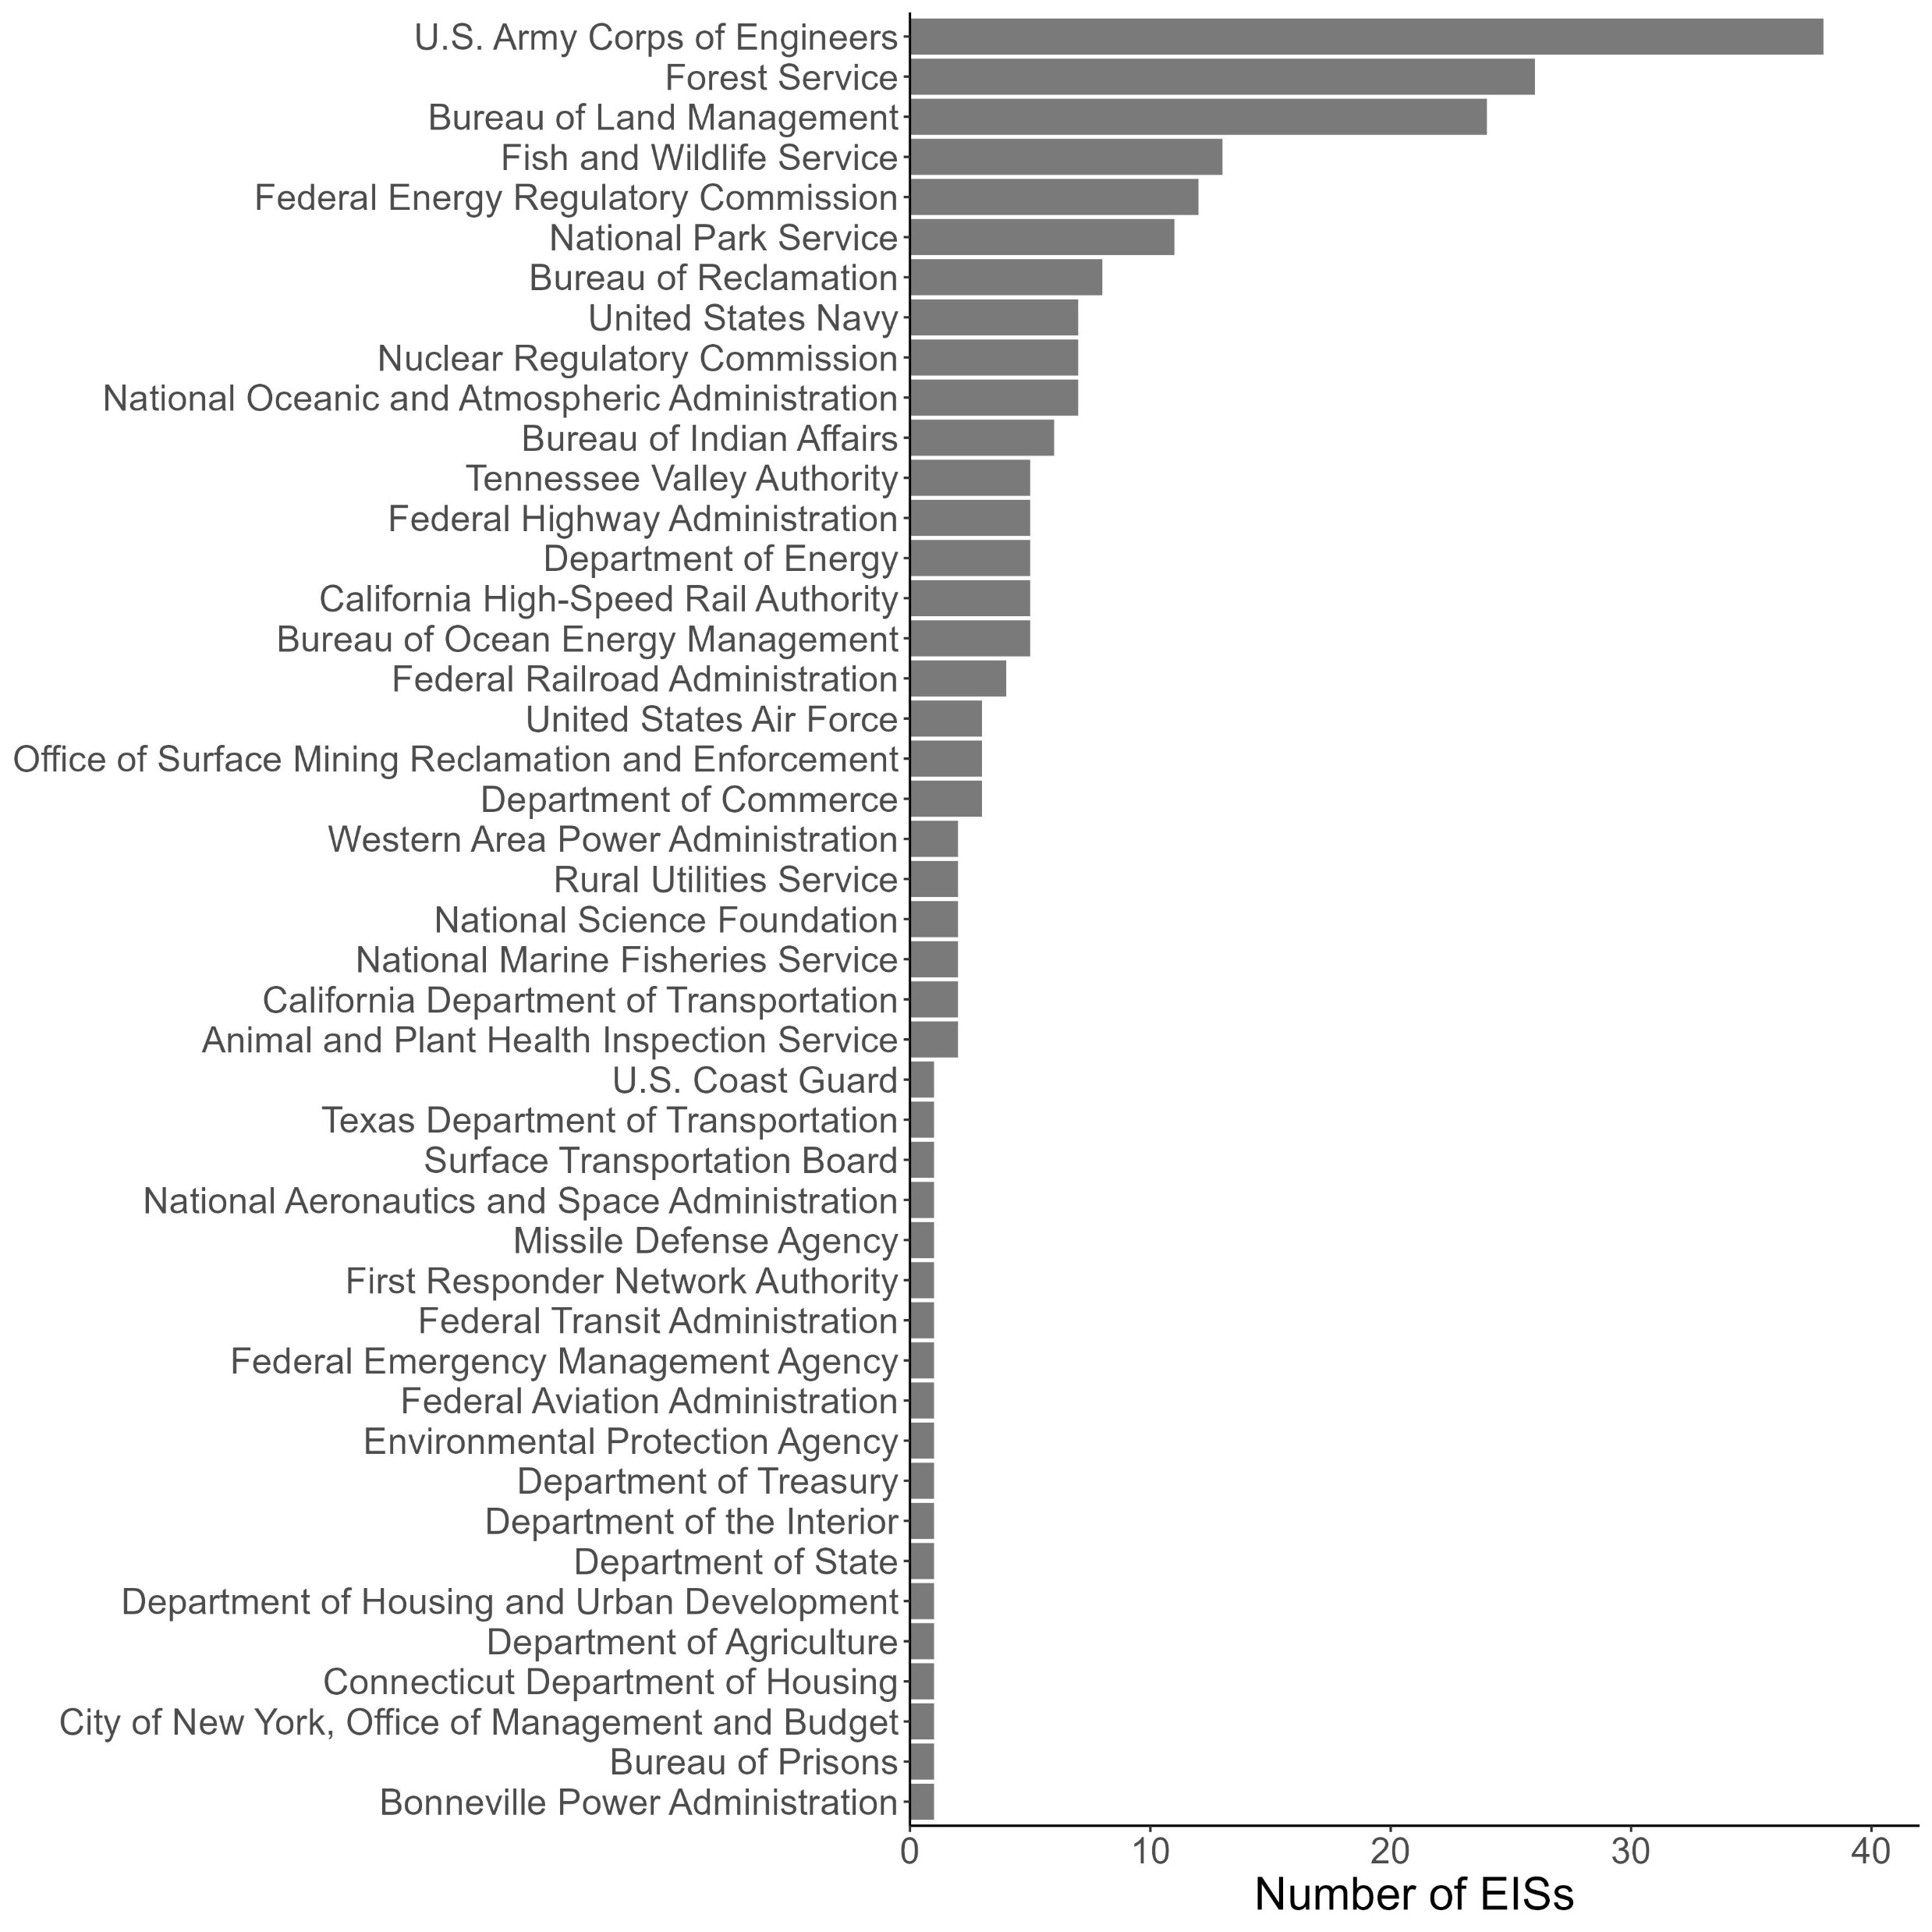
EISs using citizen science data were present across 45 agencies

Slide 25
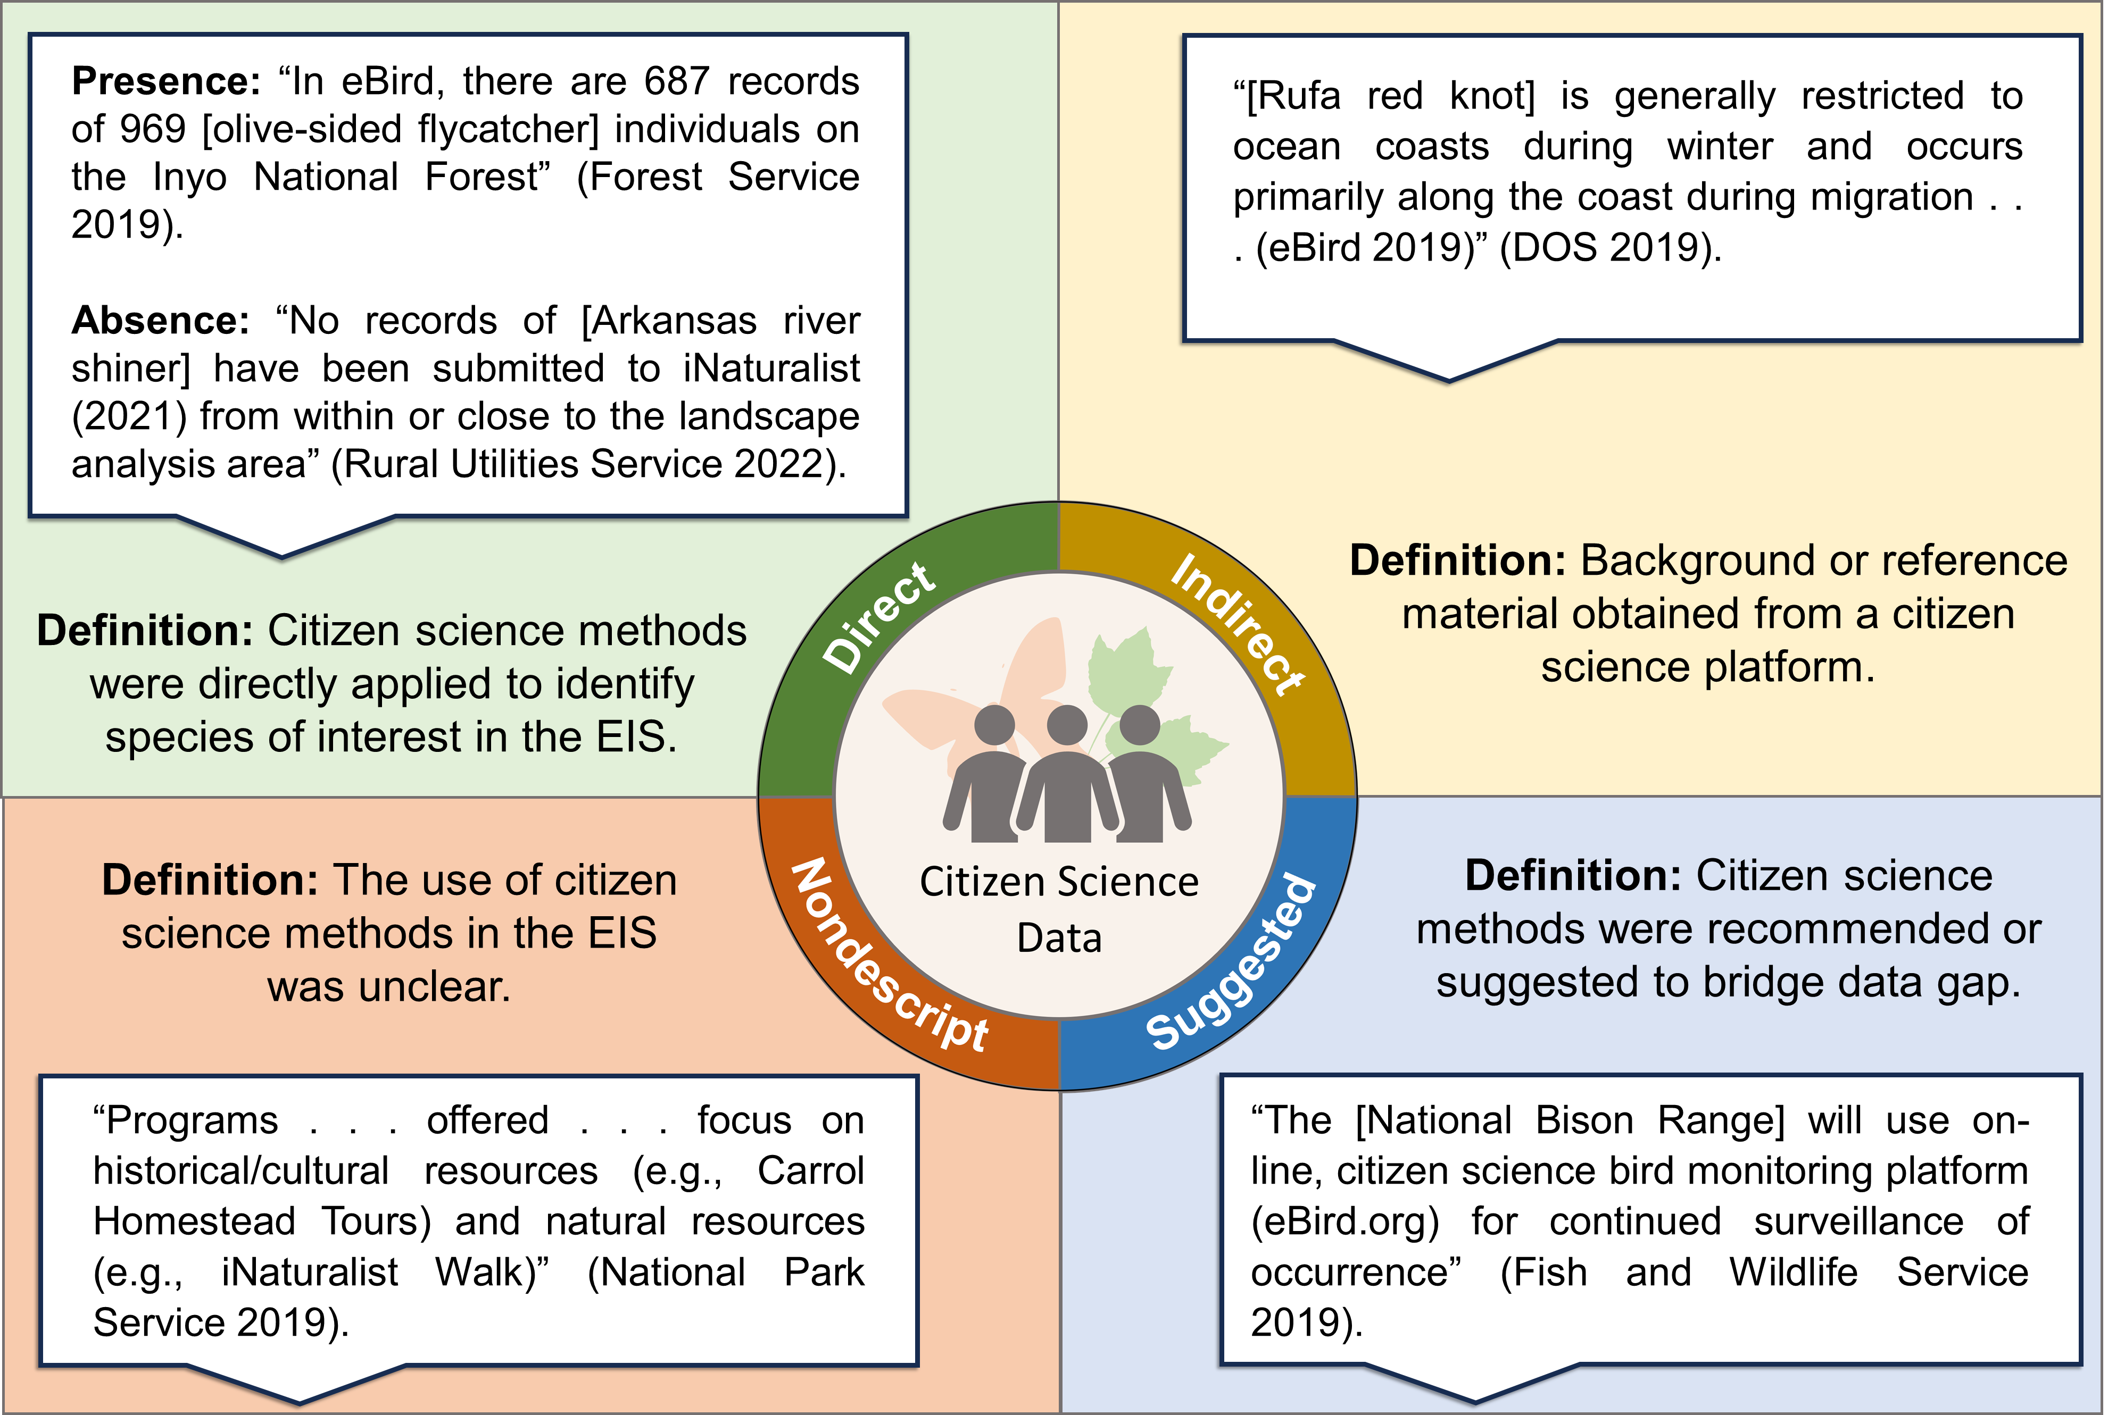

Slide 30
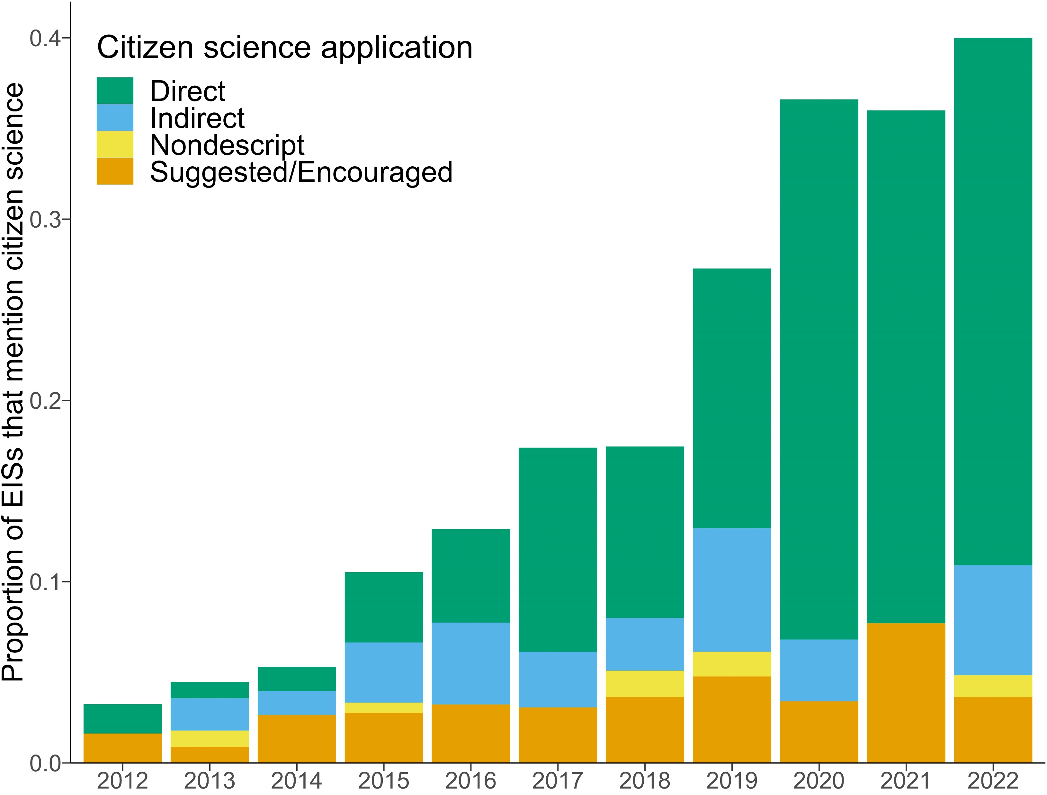

Slide 31
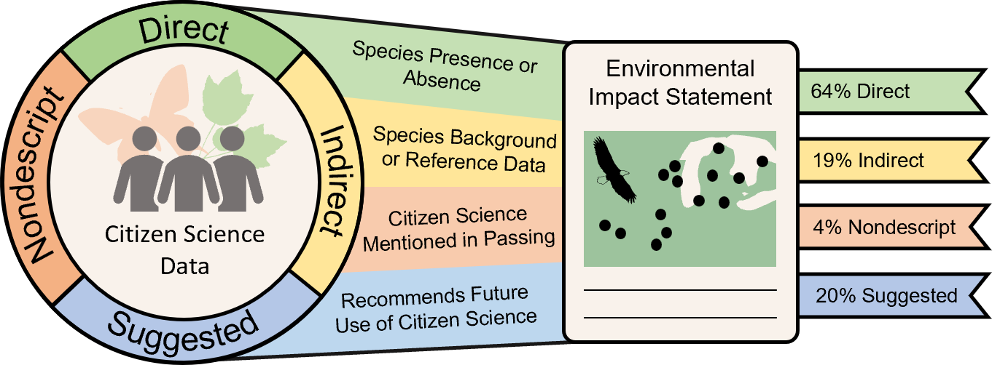

Numbers
87%
6%

Slide 32
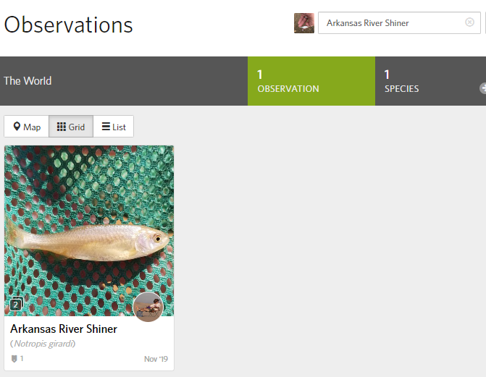
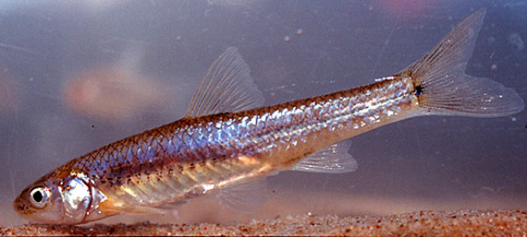
12% of all EISs used no sighting of a species as evidence of absence of that species
Photo by: Ken Collins
Worthy of future discussion
Not clear how they accounted for sampling effort or the iNaturalist location buffer for threatened species
“No records of [Arkansas river shiner] have been submitted to iNaturalist (2021) from within or close to the landscape analysis area” (Rural Utilities Service 2022)

Slide 33

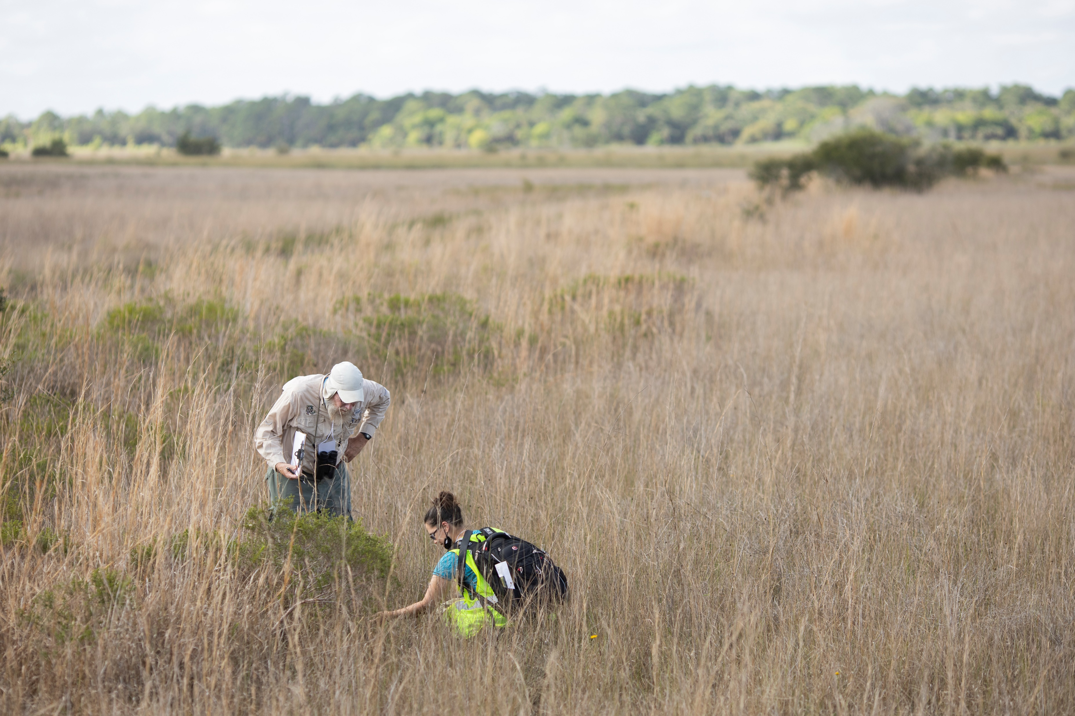


Future of Citizen Science in Environmental Review
Value of Citizen Science in Environmental Review
Agencies
Volunteers
Our results show increasing use and future potential of citizen science in environmental review
Agencies interacting with volunteers
More Data
Increased public engagement

Slide 34




Future of Citizen Science in Environmental Review
The future of citizen science use in environmental consulting is worthy of further discussion
Nuanced understanding of the data
Appropriate statistical analyses
Consider the extent that citizen science participants are willing to share data
Ensure conclusions are scientifically sound

Slide 35






How can we ensure conclusions made on citizen science data are scientifically sound?
Citizen Science is becoming more commonly used!
Policy
Research
Citizen science involves the public in the EISs process
Citizen science contributes to important scientific research (2,560 articles and growing!)
Citizen science increases data that can be used for EISs
Similar trends between articles that use iNaturalist and iNaturalist observations
Questions
Many uses of citizen science data with the most popular being species ranges
Are citizen scientists willing to share their data for EISs?
Citizen science often supplements professionally collected data or other data
How can we ensure conclusions made on citizen science data are scientifically sound?

Slide 36
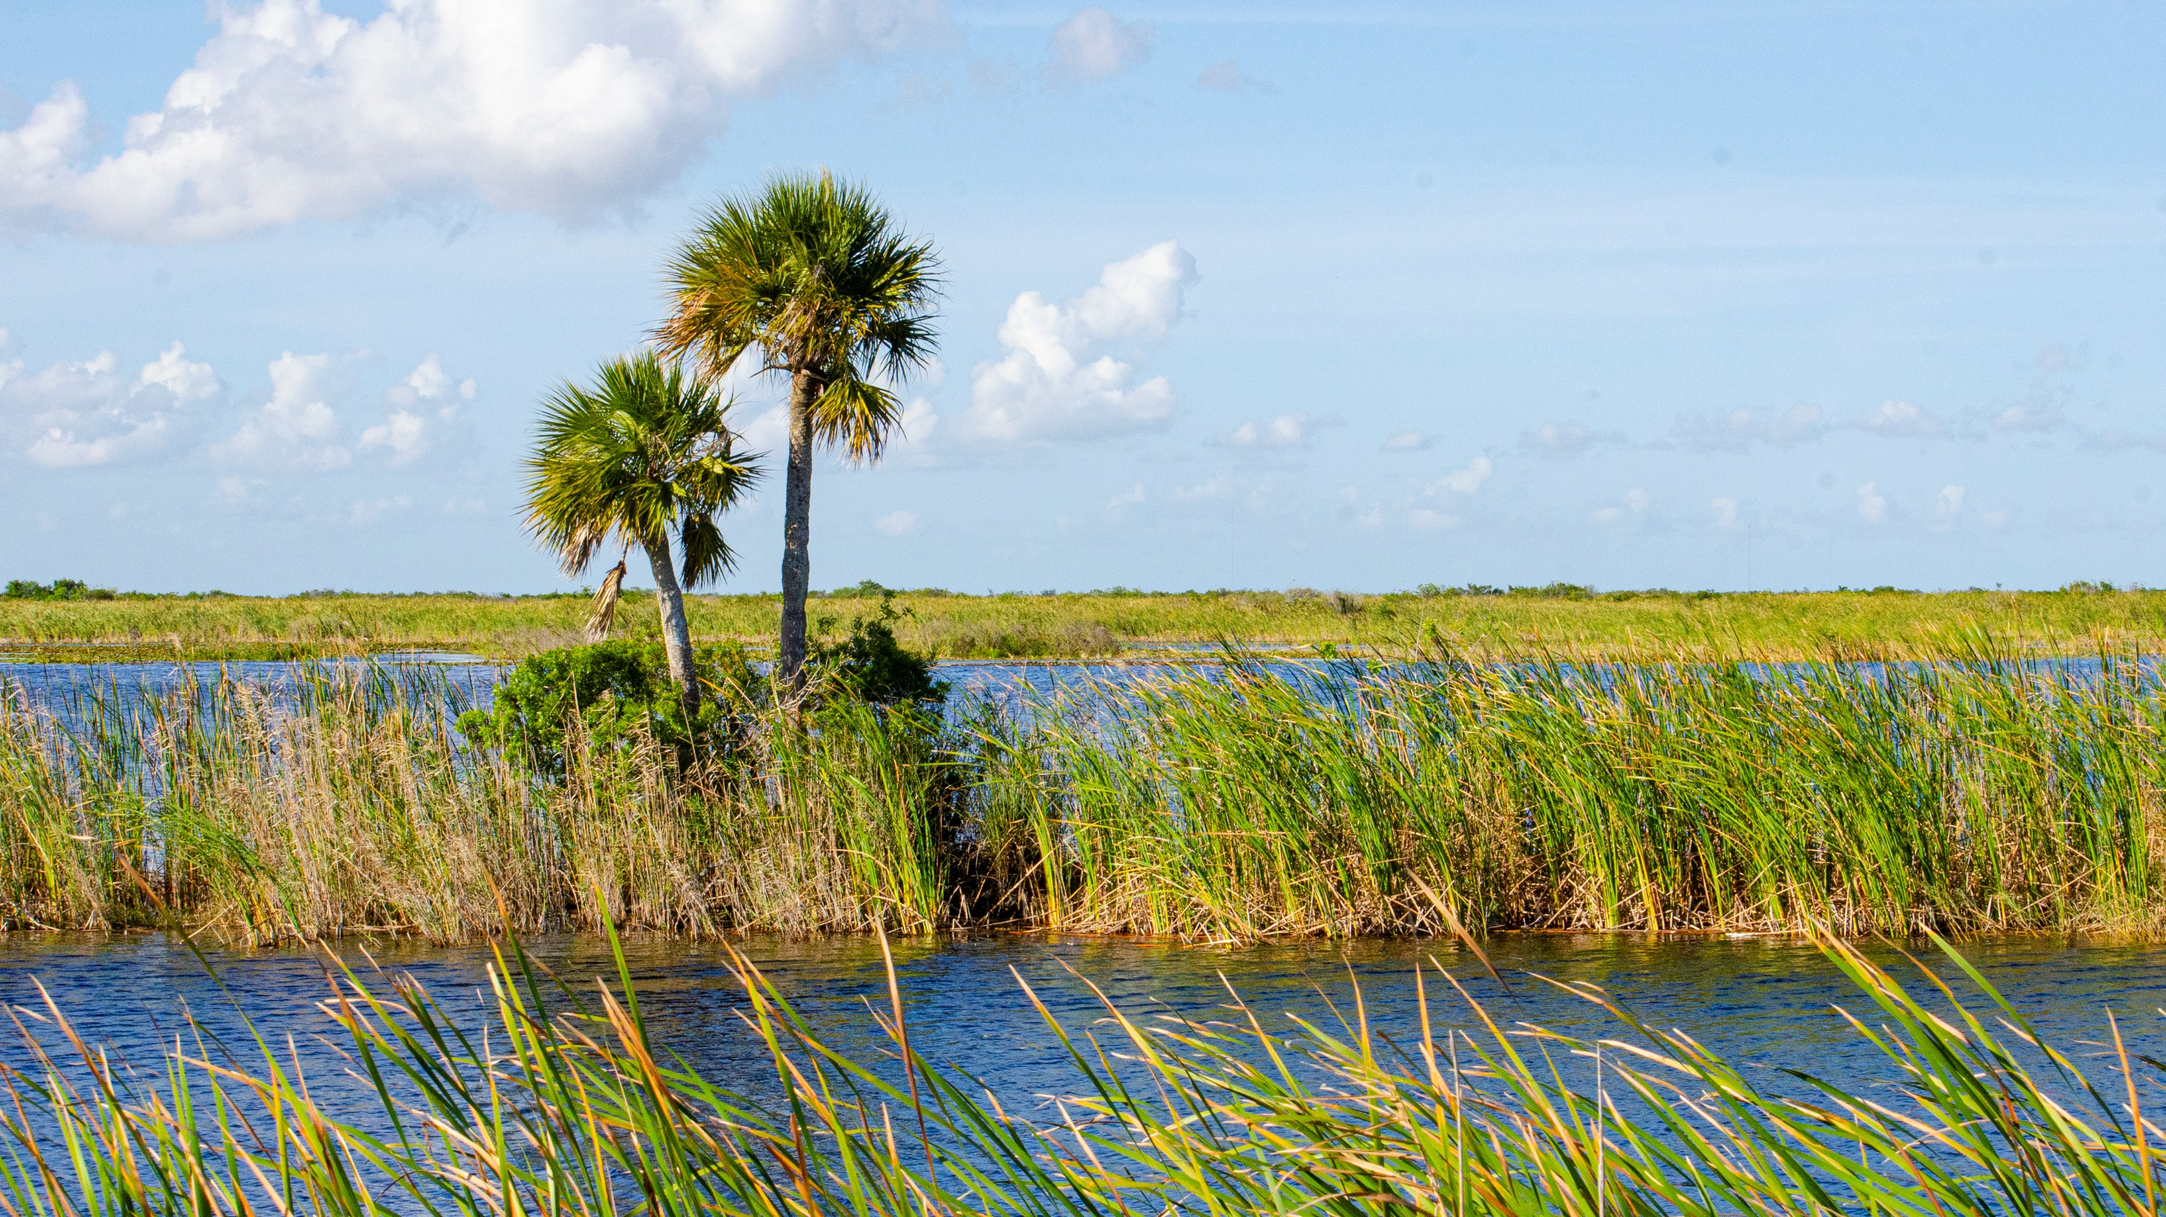
Want to learn more about iNaturalist? Join our workshop “The ins and outs of iNaturalist as a tool for quantifying biodiversity and engaging the public” From 3:00PM – 5:00PM in the Rosen Ballroom!

Slide 37
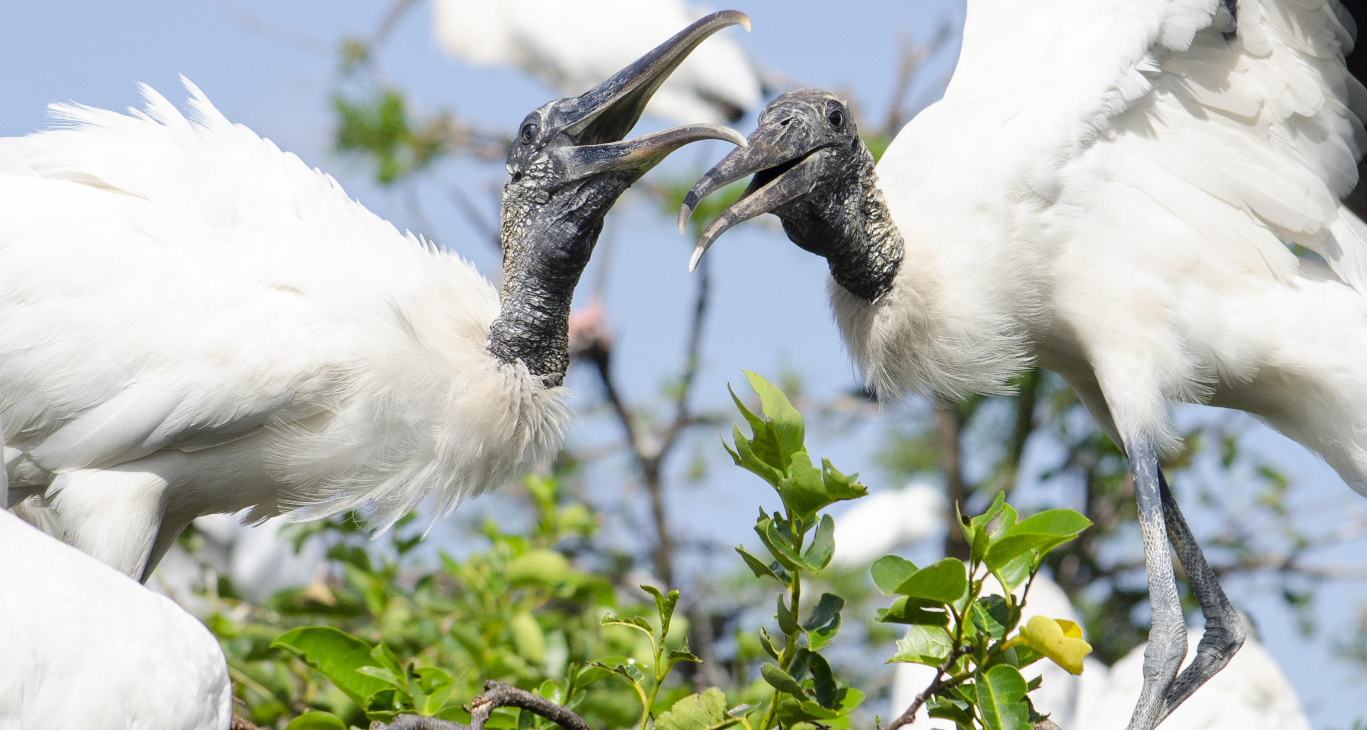
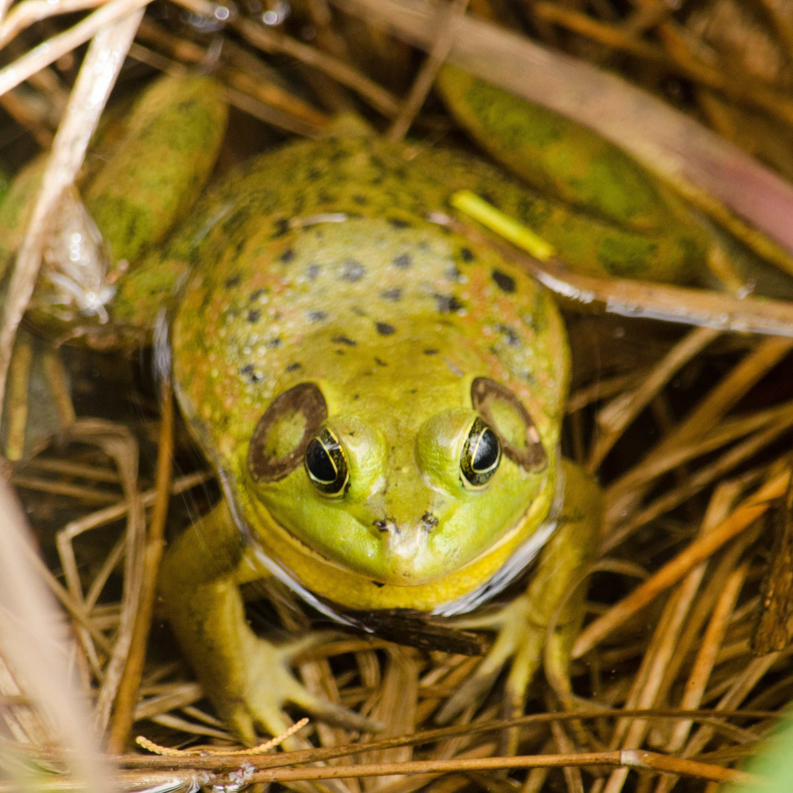
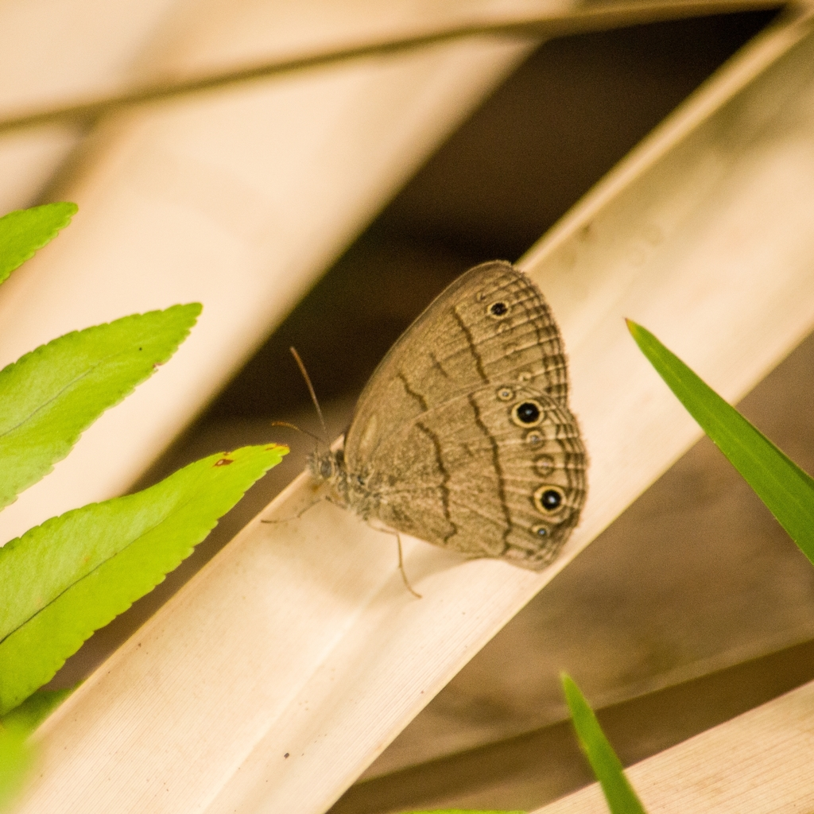
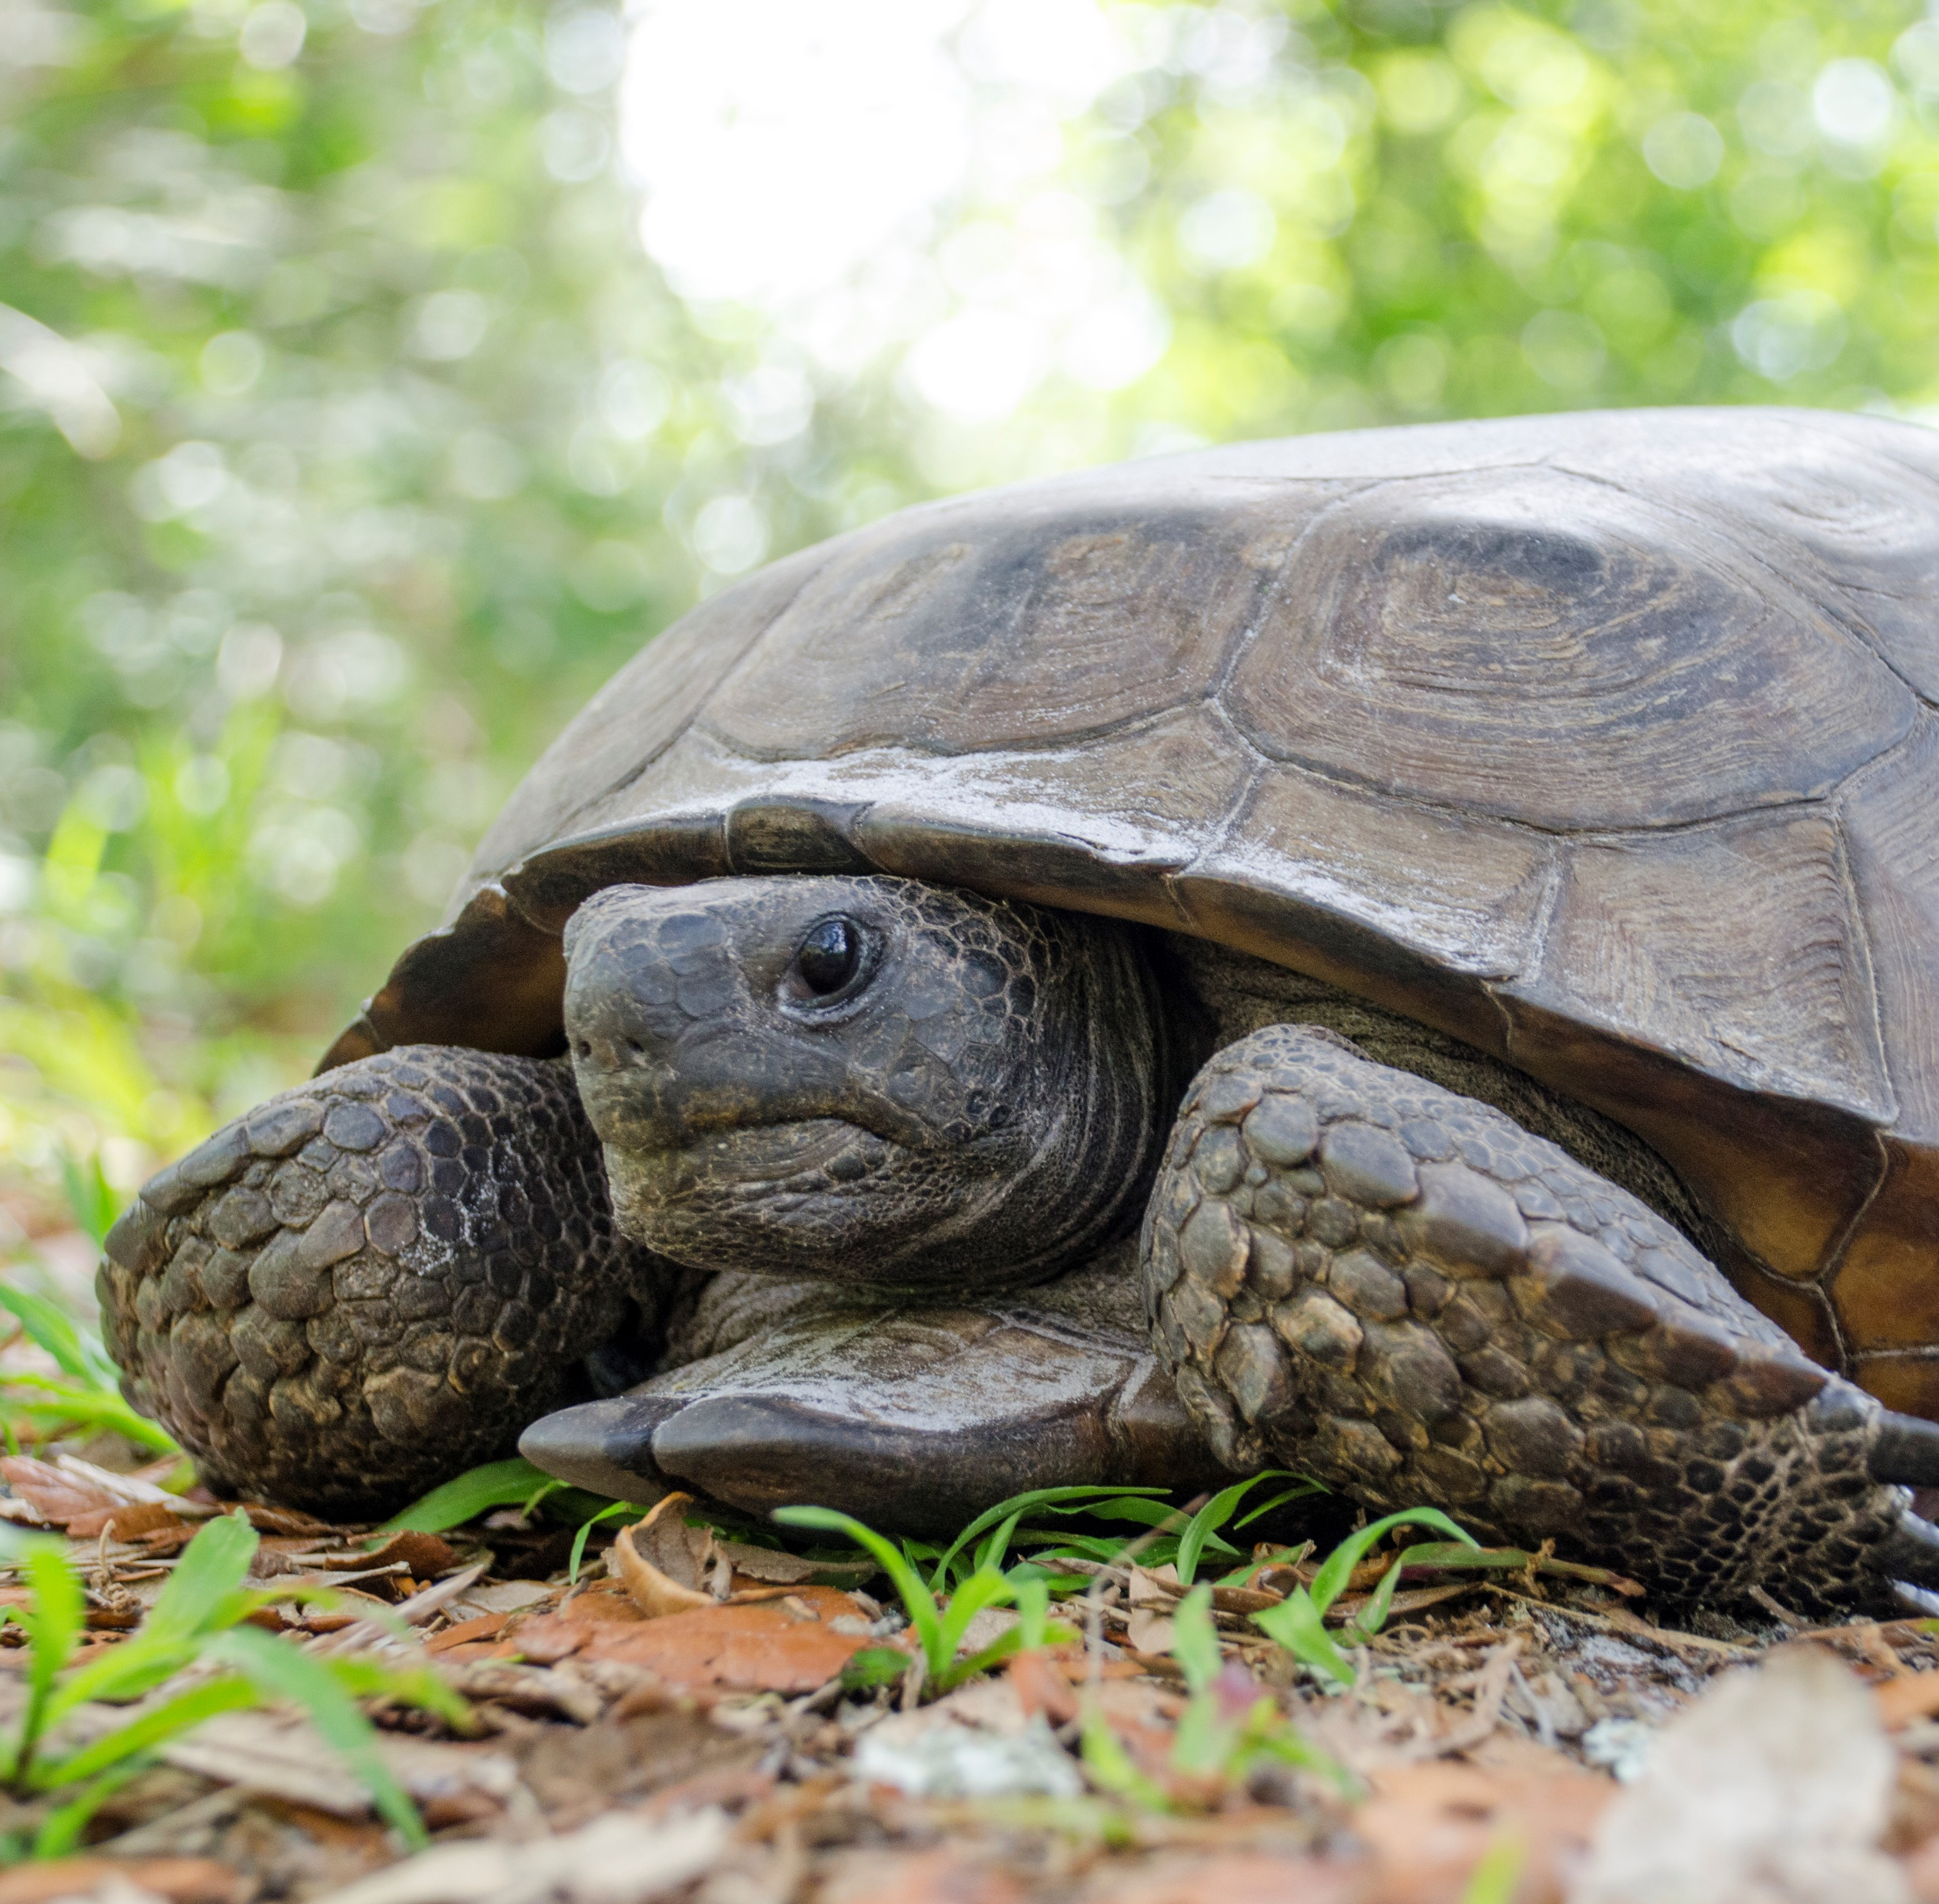
Thank you!
Brittany Mason
Data Management Analyst, UF
bmason1@ufl.edu

